Slide 1

Change the Politics, not the Climate
Thomas B. Newman, MD, MPH
Professor Emeritus of Epidemiology & Biostatistics and Pediatrics
Thanks to PSR and the Climate and Health Literacy Consortium
Notes:
Climate change represents the greatest public health threat of the 21st century. This lecture will review the science behind global warming, and its currently occurring and anticipated health effects, and provide an overview of mitigation and adaption strategies and their cobenefits.
OBJECTIVES:
1. List the main anthropogenic greenhouse gases, their relative potency, and explain how they lead to global warming
2. Describe the mechanisms by which human health is affected by environmental change, for example through changes in disease vectors, exposure to extreme weather, migration and reduced food security
3. Explain how the health impacts of environmental change are distributed unequally within and between populations and the disparity between those most responsible and those most affected by change
4. Describe how individuals and healthcare systems can reduce their carbon footprints, including benefits and limitations of carbon offsets
5. List main effects of nuclear weapons, how their explosive power is measured, and ballpark estimates of current nuclear weapons arsenals and spending.
TO ADD 4/5/17
Radiative forcing
Oceans warming
UC CNI
UCSF Progress

Slide 2
Outline
Science
Health effects
Contribution by healthcare
Mitigation and co-benefits
Closing story

Slide 3
Global warming made simple
It’s real
We’re causing it (unequally)
It’s bad for us (unequally)
There are things we can do
There are “co-benefits” to doing them
Notes:
This slide, particularly, adapted from Ed Maibach Center for Climate Change Communication
#1. Global warming is real.
#2. We’re causing it.
#3. It’s a grave threat to us, especially to our children and their children.
#4 There are things we can do
#5 There are other good reasons to do almost all of them

Slide 4
Global warming made simple
It’s real
We’re causing it (unequally)
It’s bad for us (unequally)
There are things we can do
There are “co-benefits” to doing them

Slide 5
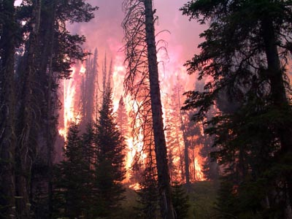
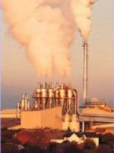
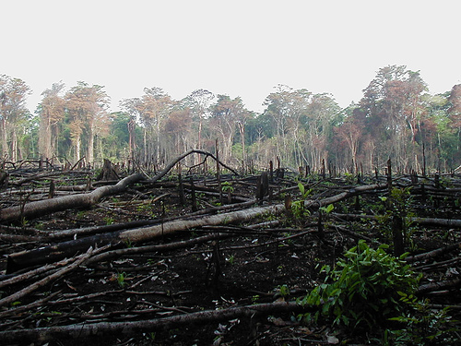
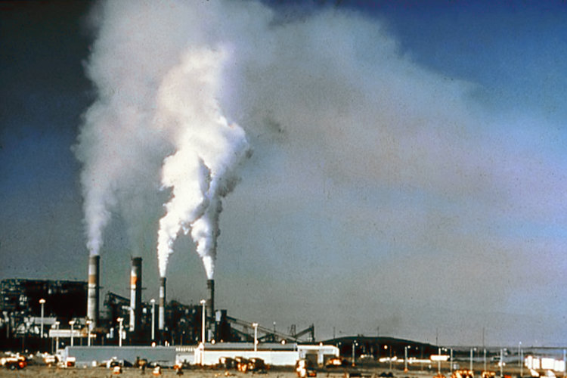
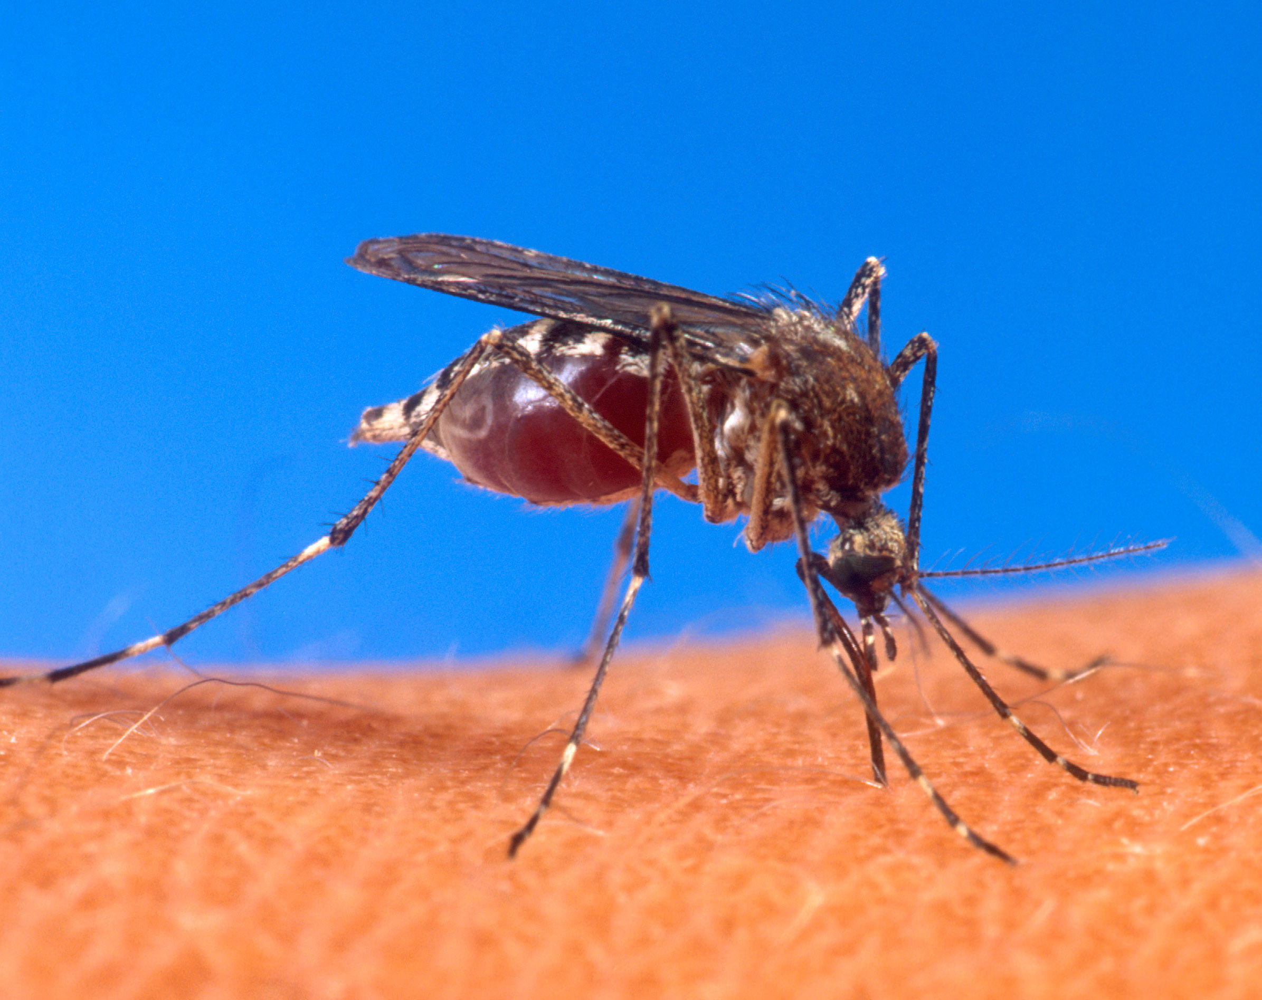
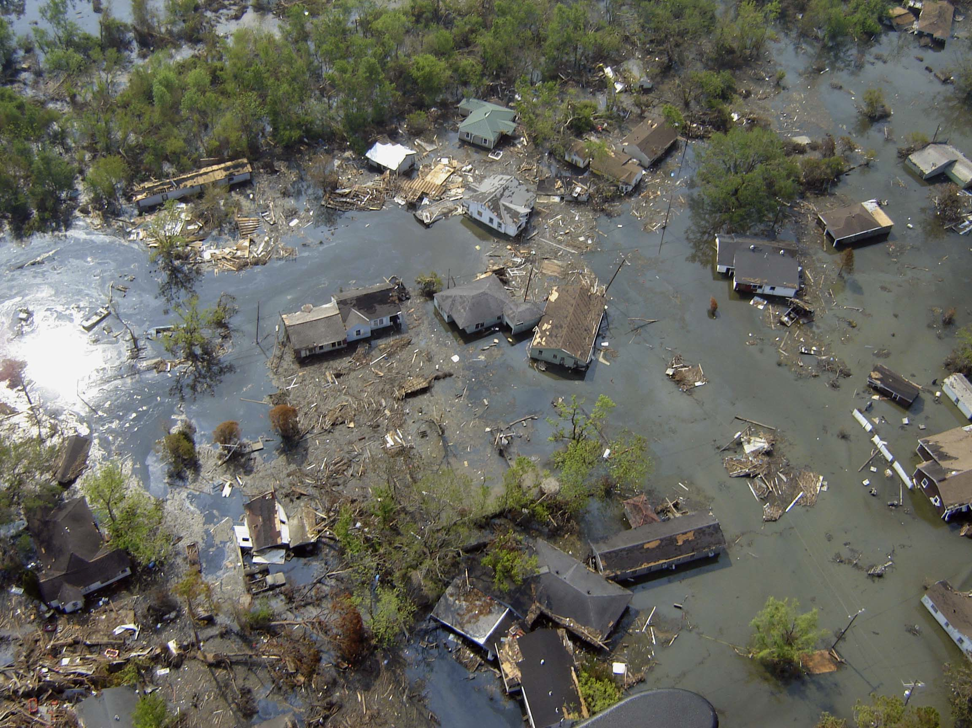
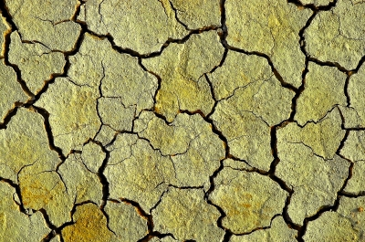
“Climate change could be the biggest global health threat of the 21st century… The impacts will be felt all around the world – and not just in some distant future but in our lifetimes and those of our children.”
--The Lancet, 11/09
Source: http://www.thelancet.com/climate-change
NOAA, Todd Heitkamp Wikimedia Commons
USEPA, Wikimedia Commons
Jami Dwyer, Wikimedia Commons
USDA, Wikimedia Commons
NOAA, Wikimedia Commons
Suat Eman, freedigitalphotos.net
Notes:
In November 2009, The Lancet and the University College London, UK released a released a report about the health impacts of climate change in future decades along with some solutions that can be implemented in the short and medium terms to mitigate these impacts.
This report called climate change the biggest global health threat of the 21st century. It examined the most serious direct and indirect consequences of climate change including “changing patterns of disease, water and food insecurity, vulnerable shelter and human settlements, extreme climate events, and population migration.”
Photo credits: Top from left to right:
-Wildfire, NOAA, Todd Heitkamp, Wikimedia Commons: http://commons.wikimedia.org/wiki/File:Waldbrand.jpg
-Air Pollution, EPA, Wikimedia Commons: http://commons.wikimedia.org/wiki/File:AirPollutionSource.jpg
-Deforestation: Jami Dwyer, Wikimedia Commons, http://commons.wikimedia.org/wiki/File:Lacanja_burn.JPG
-Air Pollution: National Parks Service, Wikimedia Commons: http://commons.wikimedia.org/wiki/File:Air_.pollution_1.jpg
Bottom left to right:
-Stegomyia aegypti mosquito, wikimedia commons, USDA: http://commons.wikimedia.org/wiki/File:Aedes_aegypti_biting_human.jpg
-Port Sulphur Louisiana after Hurricane Katrina, NOAA: http://commons.wikimedia.org/wiki/File:Katrina-port-sulphur-la-2005.jpg
-Erosion: Suat Eman, freedigitalphotos.net, http://www.freedigitalphotos.net/images/Uncategorised_g43-Erosion_p1877.html

Slide 6
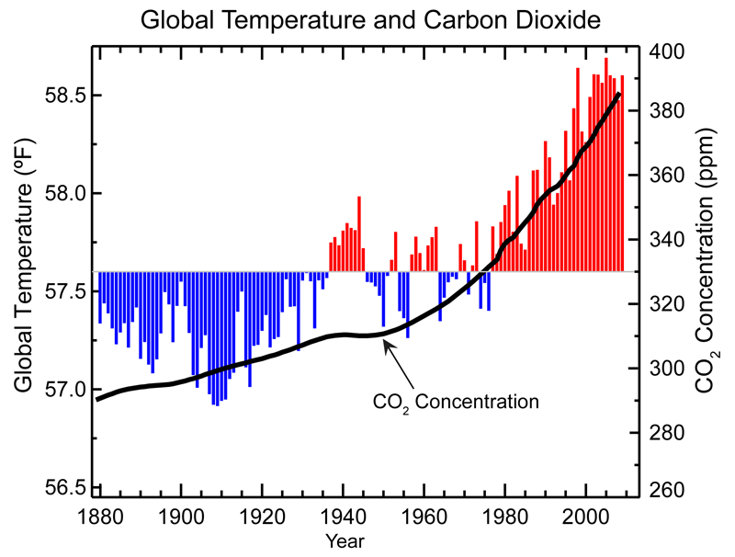
Temperatures compared with 20th century average
20th century +1.4°F
Estimates for 21st century
+4° F to +11.5° F. (IPCC, 2007)
Notes:
With the exception of a few notable cases, past shifts in the Earth’s climate have taken place relatively slowly. However, the current rate of increase in global temperatures is anything but slow and it appears only to be accelerating. Global average temperatures increased by approximately 1.4 degrees Fahrenheit during the 20th century, with 75% of this warming (or a little over 1 degree) having occurred in just the last three decades.
If energy production remains fossil-fuel intensive, the United Nations Intergovernmental Panel on Climate Change (IPCC) projects that global average temperatures likely will increase by an additional to 4 to 11.5 degrees Fahrenheit by the end of the century. Warming of this magnitude would be much larger and faster than any change in temperatures over the past 10,000 years. (1)
Source:
From: National Climate Data Center accessed 8/30/12 (http://www.ncdc.noaa.gov/indicators)
IPCC. Climate Change 2007: The Physical Science Basis, Summary for Policymakers. Contribution of Working Group I to the Fourth Assessment Report of the Intergovernmental Panel on Climate Change. Available at: http://www.ipcc.ch .. IPCC= Intergovernment Panel on Climate Change; AR4= 4th Assessment Report

Slide 7
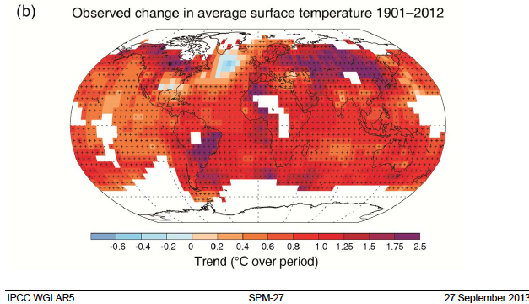
Notes:
IPCC = Intergovernmental Panel on Climate Change
WG1 = Working Group 1
AR5= 5th Assessment and Review
SPM-27 refers to Summary for Policy Makers, page 27

Slide 8
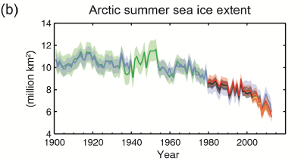
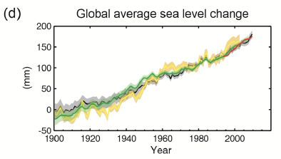
IPCC AR-5 SPM 27Sep2013, Fig 3
Notes:
From page 28 of IPCC AR-5 SPM

Slide 9
More extreme climate events, not just gradual warming
These cause most of the death and destruction
Notes:
Photo credits on Lancet slide

Slide 10
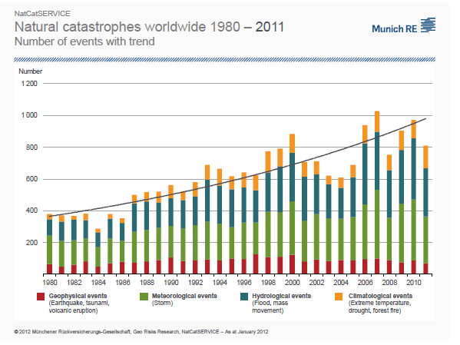
Notes:
Website gives permission to use these

Slide 11
Global warming made simple
It’s real
We’re causing it (unequally)
It’s bad for us (unequally)
There are things we can do
There are “co-benefits” to doing them

Slide 12
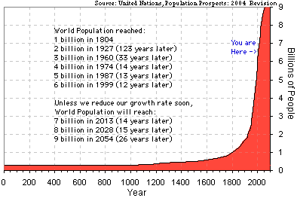
Root Cause #1: Global Population

Slide 13
The world energy system is dominated by fossil fuelsand gas
20 × increase in energy use since 1850
5 × higher population
4 × higher per capita use
Hydro + means hydro power plus renewables besides biomass
Kennedy, Donald and the Editors of Science Magazine, State of the Planet 2008-2009
EJ= Exajoules = 10¹⁸ Joules
Notes:
The growth of the world’s population and prosperity (5-fold increase in population and a 4-fold increase in energy usage per person) over the past 150 years led to a 20-fold increase in energy use, the principal source of CO2 emissions.
Growth rate from 1850-1950 was 1.45%/yr, driven mainly by coal.
From 1950-2000 it was 3.15%/yr, driven mainly by oil & natural gas.
EJ (on the y axis) stands for exajoule. It is a Unit of energy equivalent to 10^18 joules and often used as unit of measure for world annual energy use.
Source: Kennedy, Donald and the Editors of Science Magazine, State of the Planet 2008-2009, Science Magazine
http://books.google.com/books?id=dr3Mn__YCp8C&pg=PA9&lpg=PA9&dq=world+energy+consumption+1850-2000&source=bl&ots=q9rOaYq7Gj&sig=pACLCNDOd_yAYW1pf0t3wdz0rvM&hl=en&ei=7TCuS7SKLYLQsgOJjs38Cw&sa=X&oi=book_result&ct=result&resnum=7&ved=0CCkQ6AEwBg#v=onepage&q=&f=false

Slide 14
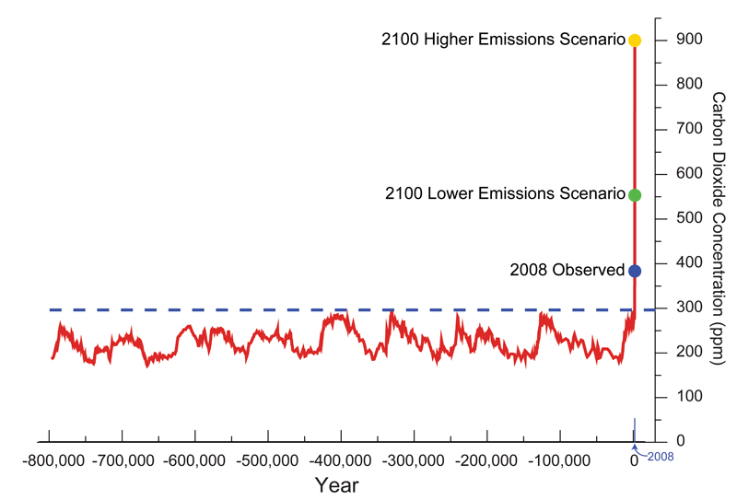
CO₂ Record from Antarctic Ice Bubbles
http://www.ncdc.noaa.gov/indicators/
Notes:
From https://www.ncdc.noaa.gov/monitoring-references/faq/indicators.php/ accessed by TN 3/9/17

Slide 15
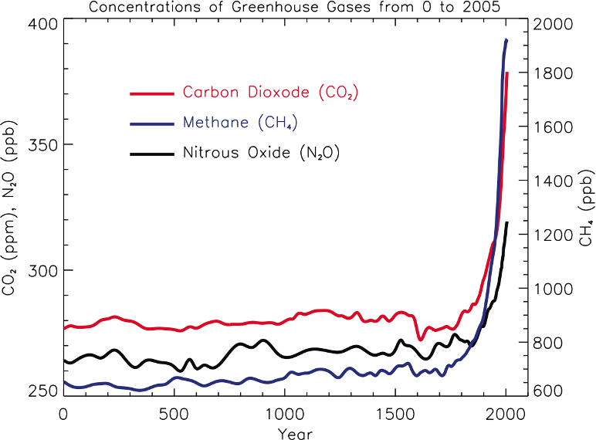
Source: IPCC, 2007
Not just CO₂
GWP*=1
GWP=23
GWP=298
*Global Warming Potential (relateive to CO₂)
Notes:
IPCC CAPTION READS: FAQ 2.1, Figure 1. Atmospheric concentrations of important long-lived greenhouse gases over the last 2,000 years. Increases since about 1750 are attributed to human activities in the industrial era. Concentration units are parts per million (ppm) or parts per billion (ppb), indicating the number of molecules of the greenhouse gas per million or billion air molecules, respectively, in an atmospheric sample. (Data combined and simplified from Chapters 6 and 2 of this report.)
GWP figures added by TN, from 2007 IPCC AR4 p212, based on 100-year time horizon via Wikipedia
Figure from: http://www.ipcc.ch/pdf/assessment-report/ar4/wg1/ar4-wg1-chapter2.pdf accessed 4/2/11
Human activities result in emissions of four principal green- house gases: carbon dioxide (CO2), methane (CH4), nitrous oxide (N2O) and the halocarbons (a group of gases containing fluorine, chlorine and bromine). These gases accumulate in the atmosphere, causing concentrations to increase with time. Significant increases in all of these gases have occurred in the industrial era (see Figure 1)…
• Carbon dioxide has increased from fossil fuel use in transportation, building heating and cooling and the manufacture of cement and other goods. Deforestation releases CO2 and re- duces its uptake by plants. Carbon dioxide is also released in natural processes such as the decay of plant matter.
• Methane has increased as a result of human activities related to agriculture, natural gas distribution and landfills. Methane is also released from natural processes that occur, for example, in wetlands. Methane concentrations are not currently increas- ing in the atmosphere because growth rates decreased over the last two decades.
Nitrousoxide is also emitted by human activities such as fertilizer use and fossil fuel burning. Natural processes in soils and the oceans also release N2O.

Slide 16
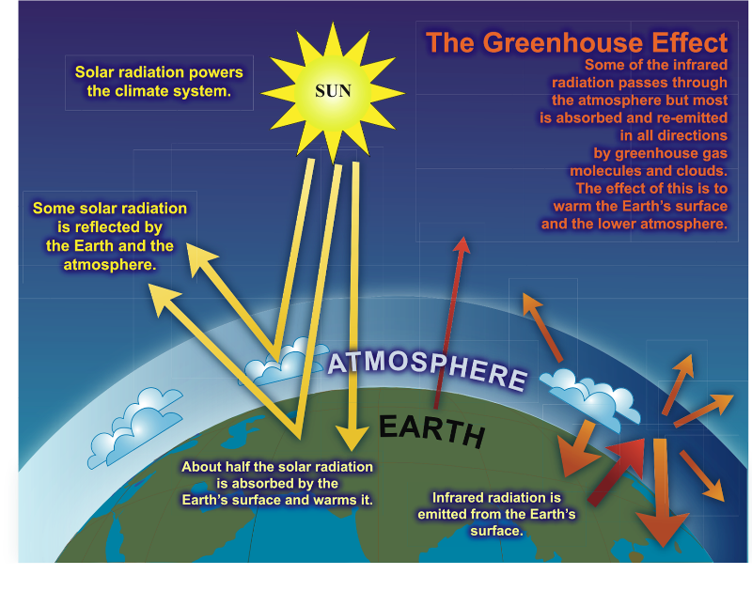
Source:
http://www.global-greenhouse-warming.com/what-is-the-greenhouse-effect.html
Notes:
The Earth has a natural temperature control system. Certain atmospheric gases, such as water vapor, CO₂, ozone, methane and nitrous oxide (N₂O) are critical to this system and are known as greenhouse gases. On average, about one third of the solar radiation that hits the earth is reflected back to space. Of the remainder, some is absorbed by the atmosphere but most is absorbed by the land and oceans. The Earth's surface becomes warm and as a result emits infrared radiation. The greenhouse gases trap the infrared radiation, thus warming the atmosphere.
More familiar than a greenhouse is a car on a summer day with the windows shut
Greenhouse gases act as a blanket to keep the earth warm.
Source:
http://www.global-greenhouse-warming.com/what-is-the-greenhouse-effect.html accessed 3/9/17
The IPCC estimates warming under different scenarios of Radiative Forcing (RF), which is measured in watts per meter squared. Radiative forcing quantifies net effects of GHG on the energy balance of the planet. Estimates are relative to 1750; total RF in 2011 was 2.29

Slide 17
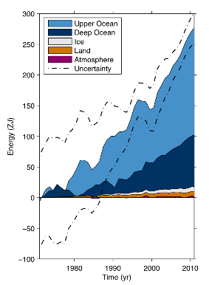
Where does the heat go?
> 90% has been absorbed by oceans
Notes:
http://www.oceanscientists.org/index.php/topics/ocean-warming
http://www.climatechange2013.org/images/uploads/WGIAR5_WGI-12Doc2b_FinalDraft_Chapter03.pdf Figure 1
Accessed 4/6/17
Box 3.1, Figure 1: Plot of energy accumulation in ZJ (1 ZJ = 10^21 J) within distinct components of Earth’s climate
system relative to 1971 and from 1971–2010 unless otherwise indicated. See text for data sources. Ocean warming (heat
content change) dominates, with the upper ocean (light blue, above 700 m) contributing more than the deep ocean (dark
blue, below 700 m; including below 2000 m estimates starting from 1992). Ice melt (light grey; for glaciers and ice
caps, Greenland and Antarctic ice sheet estimates starting from 1992, and Arctic sea ice estimate from 1979–2008);
continental (land) warming (orange); and atmospheric warming (purple; estimate starting from 1979) make smaller
contributions. Uncertainty in the ocean estimate also dominates the total uncertainty (dot-dashed lines about the error
from all five components at 90% confidence intervals).

Slide 18
Climate change models
Best science summary from Intergovernmental Panel on Climate Change (IPCC)
5th Assessment Report (AR-5) released 10/1/13: 130 countries, 450 lead authors, 2500 expert reviewers, all volunteers
Peer review process - high level of transparency and scrutiny
Google “IPCC”
Notes:
IPCC – Established in 1988 by the World Meteorological Organization and the United Nationals Environment Programme.
It is an inter-governmental scientific body that evaluates the risks of climate change caused by human activities. The IPCC bases its scientific assessments on peer reviewed research and publications, is reports are the most widely cited in climate change literature and it is considered nationally and internationally to be the most authoritative voice on climate change science and causes. The IPCC has released comprehensive reports in 1990, 1996, 2001 and 2007. It is currently writing a fifth assessment report: Climate Change 2014.
Scientific consensus on climate change and peer review:
Example: the fourth assessment (2007)
Experts from 130 countries contributed to this assessment over the course of 6 years. There were 450 lead authors, 800 contributing authors and 2500 expert reviewers.
The IPCC credibility comes from the extensive transparent and iterative peer review process that is more exhaustive and comprehensive than scientific journals. Anyone can become a reviewer, but pledge confientiality. See http://www.huffingtonpost.com/2012/12/14/leaked-ipcc-report_n_2300558.html#slide=1833760.
In the review process, if major differences in opinions arise, lead authors meet with the contributors and editors to discuss and resolve the differences.
Represents a multitude of expert opinions, including skeptics and people from all sides of the political spectrum. NGOs can participate as observers, climate change contrarians are contributing authors and advisors, industry representatives (ExxonMobil, Electric Power Research Institute), environmental scientists (Environmental Defense, Natural Resources Defense Council)
Sources:
Union of Concerned Scientists, http://www.ucsusa.org/global_warming/science_and_impacts/science/ipcc-backgrounder.html
IPCC, http://www.ipcc.ch/organization/organization.htm
AR-5

Slide 19
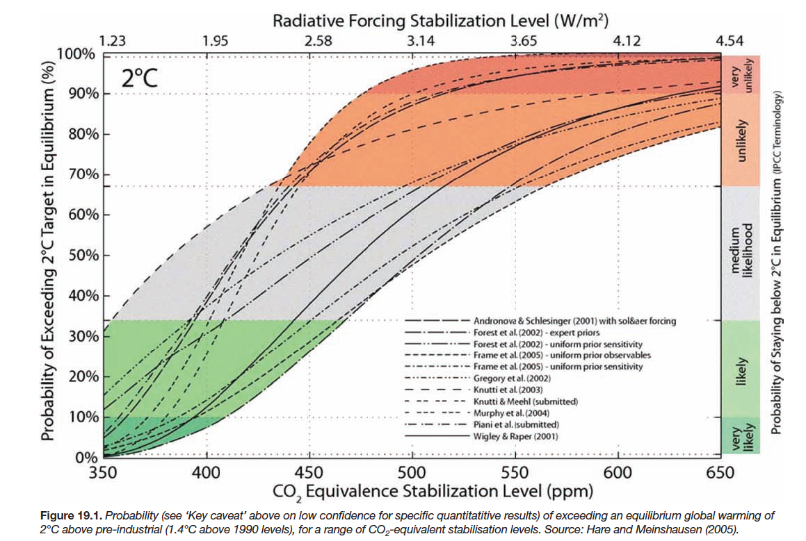
Climate change models
= 3.6° F
Notes:
TN: This slide shows how the IPCC considers a range of estimates from different models, in this case about the probability of a > 2 degree C increase in average temperature and the level of CO₂. (Universal agreement in Copenhagen that >2 degree C rise would be catastrophic)
TO avoid risking this level of potentially catastrophic warming (at > 10%), we need to keep that below 350 ppm, hence the organization www.350.org.
Source: IPCC AR-4, accessed 3/9/17 https://www.ipcc.ch/publications_and_data/ar4/wg2/en/ch19s19-4-2-2.html
Radiative forcing is measured in watts per m^2, is the difference between energy coming in and radiated back out. It is defined relative to pre-industrial (1750) levels.

Slide 20
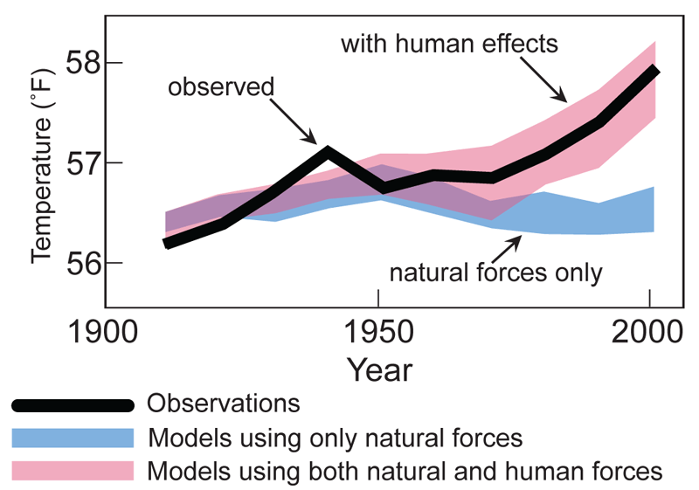
Global Average Temperature Models
https://www.ncdc.noaa.gov/monitoring-references/faq/indicators.php
Notes:
From: https://www.ncdc.noaa.gov/monitoring-references/faq/indicators.php accessed 3/9/17
TN: We use models to predict the weather (short term) and the climate (long term). We then can see how well the models fit; if the models don’t fit, it means there is something going on that isn’t in the model. When we look at what has been happening to the climate, models that include human activities fit, and those with natural forces only do not.
NOAA = National Oceanic and Atmospheric Administration
NOAA's National Centers for Environmental Information (NCEI) is responsible for preserving, monitoring, assessing, and providing public access to the Nation's treasure of climate and historical weather data and information

Slide 21
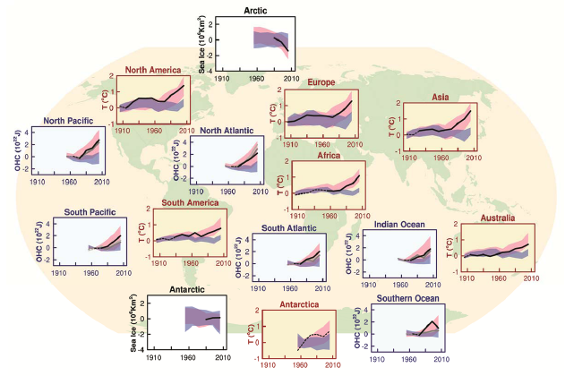
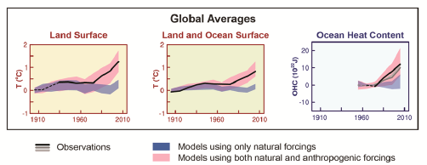
IPCC AR-5
Notes:
Source: IPCC AR-5 Final, page 49 (which is page 66 of the pdf).

Slide 22
Positive feedback loops increase uncertainty
Warmer temperatures → ice melts → less heat is reflected, more heat is absorbed → warmer temperatures
Warmer temperatures → more water vapor (a greenhouse gas) → warmer temperatures
Warmer temperatures → permafrost melts → release of methane → warmer temperatures
Notes:
TN:These are things that lead to the most uncertainty.

Slide 23
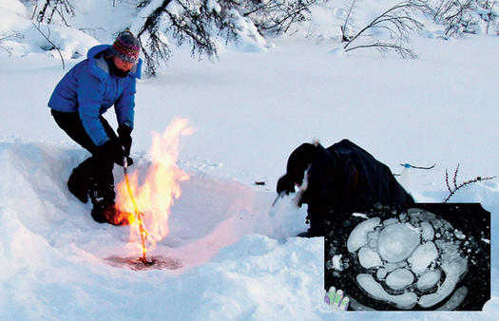
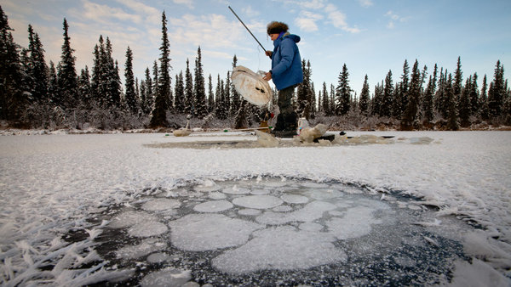
Methane release from melting permafrost
Twice as much carbon in permafrost as in the atmosphere
It’s melting
http://www.popsci.com/environment/article/2009-02/big-thaw-0?page=3. Researcher Katey Walter sets methane locked in ice ablaze.
http://www.nytimes.com/2011/12/17/science/earth/warming-arctic-permafrost-fuels-climate-change-worries.html?pagewanted=all
Notes:
Top photo from http://www.popsci.com/environment/article/2009-02/big-thaw-0?page=3: Bubble, Bubble: Researcher Katey Walter sets methane locked in ice ablaze. Methane bubbles up from a thaw lake [inset]. Sergey Zimov; K. Walter/AP/Polfoto.
Bottom photo NYT

Slide 24
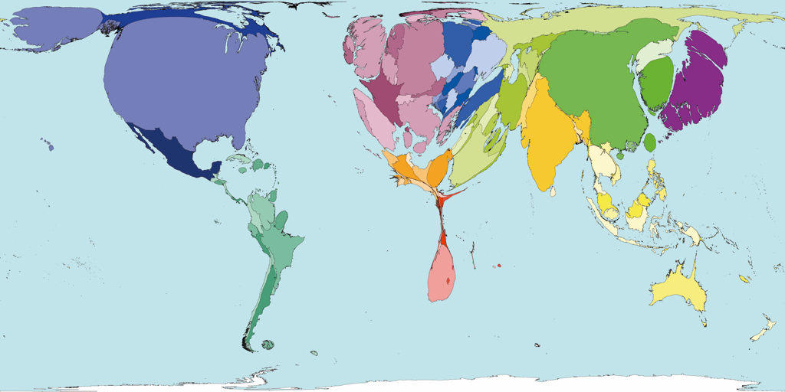
We are causing it (unequally)…
USA: 4% of world’s population, 25% of greenhouse gas emissions
Carbon emissions, 2000
http://www.worldmapper.org/display.php?selected=295
Notes:
Some of us are much more responsible for the warming than others. In the United States, we are responsible for one-fourth of all greenhouse gas emissions, worldwide.
China just passed the US as the biggest overall greenhouse gas polluter, but China has 4 people for every one person in the US. This means, on a per person basis, the average American still creates nearly 4 times more greenhouse gas pollution that does the average Chinese.
The map you see here, from 2000, is a representation of which countries are contributing most to the dangerous warming of our planet. You will immediately notice the enlarged size of the US here, in comparison to what you would normally expect to see.

Slide 25
Healthcare sector contribution
17.8% of GDP in 2015¹
  $3.2 trillion
  $10,000 per person
Healthcare sector buildings are energy intensive²
  $11.5 billion in energy costs
  The EPA estimates healthcare energy use could be reduced by 30%
1. https://www.cms.gov/research-statistics-data-and-systems/statistics-trends-
and-reports/nationalhealthexpenddata/nationalhealthaccountshistorical.html
2. https://betterbuildingssolutioncenter.energy.gov/alliance/sectors
Notes:
Practice Green health: Addressing Climate Change in the healthcare setting: Opportunities for action
https://practicegreenhealth.org/pubs/toolkit/reports/ClimateChange.pdf
$3.2 trillion or $9,990 per person
17.8% of GDP: ttps://www.cms.gov/research-statistics-data-and-systems/statistics-trends-and-reports/nationalhealthexpenddata/nationalhealthaccountshistorical.html accessed 3/9/17
Energy costs: https://betterbuildingssolutioncenter.energy.gov/alliance/sectors

Slide 26
Global warming made simple
It’s real
We’re causing it (unequally)
It’s bad for us (unequally)
There are things we can do
There are “co-benefits” to doing them
Notes:
This slide, particularly, adapted from Ed Maibach Center for Climate Change Communication
#1. Global warming is real.
#2. We’re causing it.
#3. It’s a grave threat to us, especially to our children and their children.
#4 There are things we can do
#5 There are other good raesons to do almost all of them
We’re going to talk about all of these things today, but we’re going to spend most of our time talking about the 3rd point – the fact that global warming is very bad for people, not just bad for plants, penguins and polar bears – and the 4th point – that we can solve this problem -- because my mission as a public health professional is to help create a community, and a world, in which we and our children, can all live as healthfully as possible. For that to remain true, there are some important steps we are going to have to take.
Finally, I think this last point -- co-benefits– is very important. By that I mean that many of the steps we need to take would be good things to do even if they weren’t necessary to reduce the impact of global climate change.

Slide 27
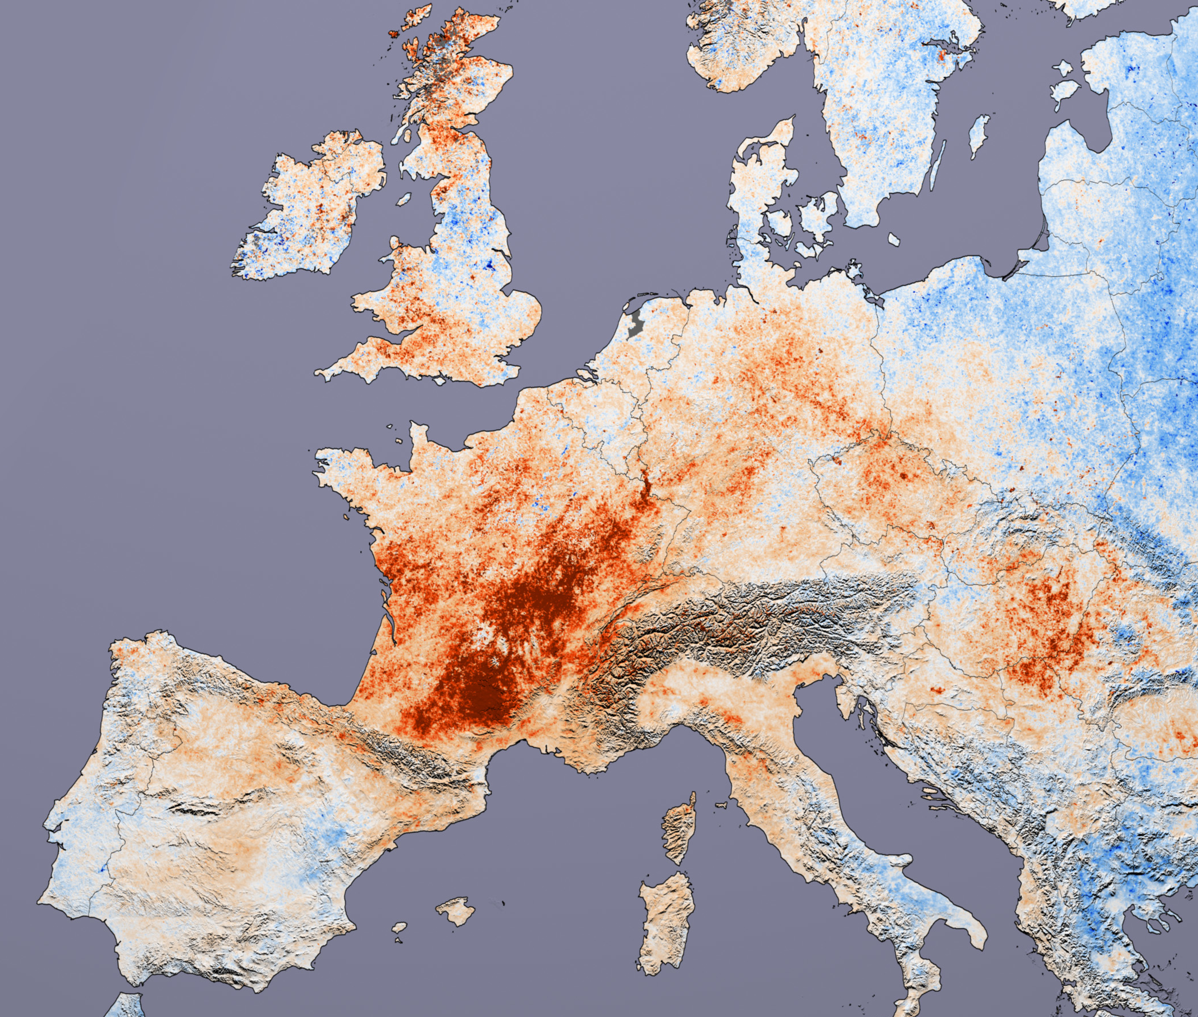
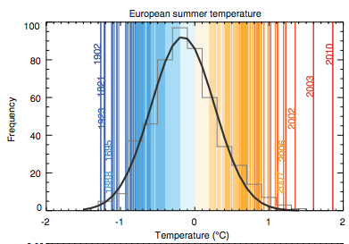
Heat Waves
2003 European heat wave¹
Excess deaths > 80,000
2006 California heat wave²
Excess ED visits: ~16,000
Excess hospitalizations: ~1200
2010 Eastern Europe and Russian heat wave³
broke 500-year temperature records
55,000 excess deaths in Russia alone
NASA
1. Robine JM et al. 2003 Heatwave project.
2. Knowlton K et al. Environ Health Perspect. 2009 Jan; 117(1): 61–67
3. Barriopedro et al. Science 2011;332:220; http://www.reuters.com/article/us-russia-heat-deaths-idUSTRE69O4LB20101025
NASA
Notes:
Ref for excess deaths in Europe: http://ec.europa.eu/health/ph_projects/2005/action1/docs/action1_2005_a2_15_en.pdf
California has already begun to feel the effects of extreme heat.
https://www.ncbi.nlm.nih.gov/pubmed/19165388 Environ Health Perspect. 2009 Jan; 117(1): 61–67
For example, during the California heat wave of 2006:
Daytime temperatures went above 100 degrees for two weeks
We experienced record night time highs
California Photo: NASA, http://www.nasaimages.org/luna/servlet/detail/nasaNAS~10~10~67510~172326:Springtime-Heat-Wave-Bakes-Southern
Europe Photo: http://images.google.com/imgres?imgurl=http://veimages.gsfc.nasa.gov/18752/modis_lst_europe_2001-2003_lrg.jpg&imgrefurl=http://visibleearth.nasa.gov/view_rec.php%3Fid%3D18752&usg=__lTihKPia6xSwVQ5pFL2vLBVwJ7Q=&h=1800&w=2124&sz=1399&hl=en&start=32&um=1&itbs=1&tbnid=kXYUrQN27hFprM:&tbnh=127&tbnw=150&prev=/images%3Fq%3Dheat%2Bwave%26start%3D18%26um%3D1%26hl%3Den%26client%3Dsafari%26sa%3DN%26rls%3Den%26as_rights%3D(cc_publicdomain%257Ccc_attribute%257Ccc_sharealike%257Ccc_noncommercial%257Ccc_nonderived)%26as_st%3Dy%26ndsp%3D18%26tbs%3Disch:1

Slide 28
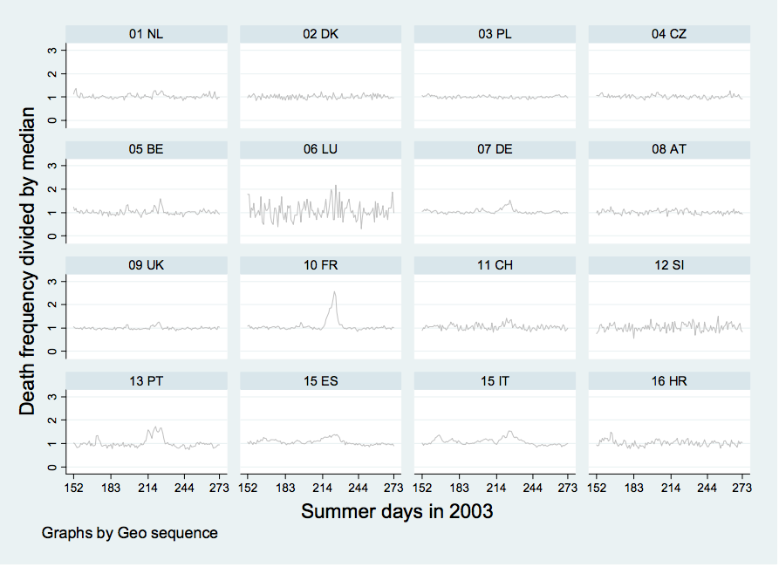
Deaths during European heat wave of 2003
: http://ec.europa.eu/health/ph_projects/2005/action1/docs/action1_2005_a2_15_en.pdf
Notes:
Just looking at heat as cause of death on death certificates can underestimate deaths. Many heat-related deaths may be coded as heart attacks or other causes.
This shows it is not just accelerating deaths of very fragile people who would have died soon anyway − there’s no dip after the spike seen in France.
FR= France
LU = Luxemborg
PL= Poland
PT= Portugal
IT= Italy
BE= Belgium
DE= Germany

Slide 29
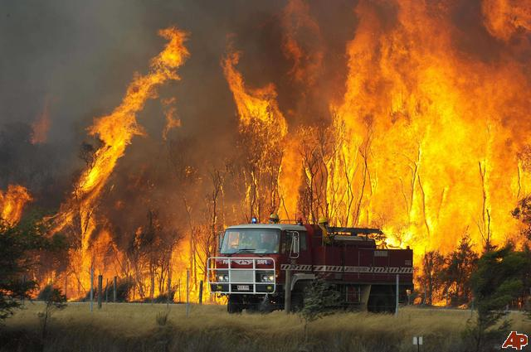
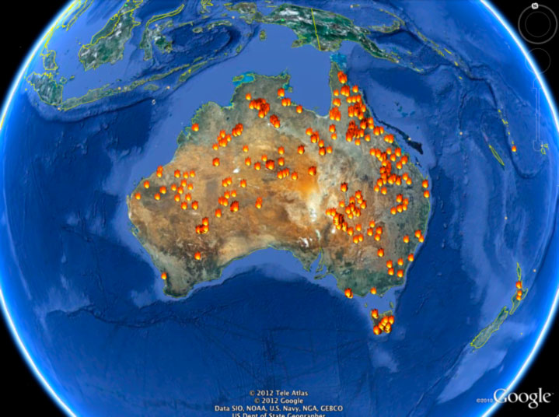
Increase in Wildfires
4x increase in major fires, 6x increase in area burned in Western US, 1987-2005 vs. 1970-86*
Increased particulate pollutants and ozone
Most vulnerable: elderly, children, people with respiratory illnesses
Another positive feedback loop
*Westerling et al. Science 2006; 313:940-943
Photos: FEMA, Florida Division of Forestry
Notes:
A fire truck moves away from out of control flames from a bushfire in the Bunyip Sate Forest near the township of Tonimbuk, 125 kilometers (78 miles) west of Melbourne, Saturday, Feb. 7, 2009. Walls of flame roared across southeastern Australia, razing scores of homes, forests and farmland in the sunburned country's worst wildfire disaster in a quarter century. (AP Photo) http://newshopper.sulekha.com/australia-wildfires_photo_665325.htm
Photo 2 http://blogs.discovermagazine.com/80beats/2013/01/08/record-breaking-heat-fuels-raging-brushfires-in-australia/#.UPH11I4U5Ws accessed 3/19/17
http://www.sciencemag.org/content/313/5789/940.full

Slide 30
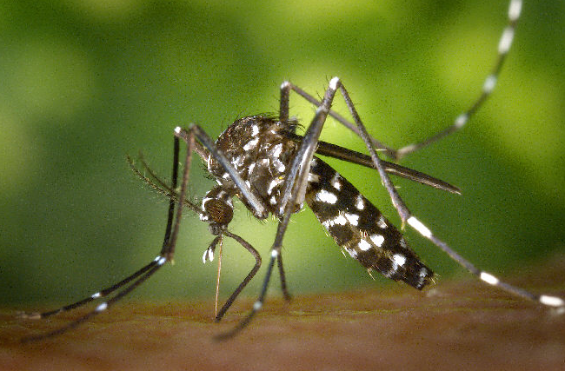
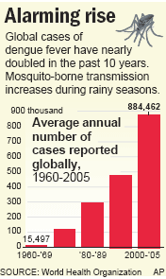
Infectious Diseases
Increased geographical range and risk of vector-borne diseases
  West Nile Virus
  Dengue Fever
  Chikungunya
  Malaria
Waterborne illnesses due to flooding, societal disruption (e.g., cholera)
CDC/ Wikimedia Commons
USDA
Notes:
Increased temperature, rainfall variability and altered dynamics of reservoir populations are predicted to increase the transmission of some zoonotic diseases. Changes may permit establishment of novel imported infectious diseases in regions that were previously unable to support endemic transmission.
• Changes likely to vary geographically.
• Increased temperature shortens pathogen development time in vectors. This increases the duration of infectiousness, allowing for prolonged periods of transmission to humans.
• Changes in climate may expand the geographic range and abundance in both vectors and reservoir hosts.
• Warming and altered rainfall patterns may increase populations of reservoir animals and their predators (e.g., rabbits and foxes).
• Early onset of favorable transmission conditions may prolong transmission cycles.
• Flooding provides breeding habitats for vectors and reservoir hosts, increasing their abundance and geographic range, which may lead to more frequent outbreaks of diseases.
• Increased risk of travel-associated illnesses.
- Mass migrations of climate refugees could increase human-to-human transmissions
Source: Greer, Ng, Fisman, CMAJ 2008;178(6):715-22
Chikungunya: “A viral illness that is spread by the bite of infected mosquitoes. The disease resembles dengue fever, and is characterized by severe, sometimes persistent joint pain (arthritis) as well as fever and rash. It is rarely life-threatening. http://www.searo.who.int/en/Section10/Section2246.htm
Tularemia: a bacterial disease characterized by skin ulcers, swollen and painful lymph glands, inflamed eyes, soar throat, mouth sores, diarrhea or pneumonia. People can be infected through infected insect bites (ticks and deerflies), by handling infect animals, by eating or drinking contaminated food or water, or by inhaling airborne bacteria. It can be treated by antibiotics. http://www.bt.cdc.gov/agent/tularemia/faq.asp
Dengue Fever: This viral disease is transmitted by mosquitoes. It can be fatal if unrecognized or not properly treated. Symptoms include high fever, severe headache, join pain. The disease is most prevalent in tropical regions. http://www.cdc.gov/dengue/fAQFacts/index.html
Malaria:
It’s not just the direct, highly visible impacts of flooding, drought, hurricanes and heat waves that comprise the health threats posed by global warming. Rising temperatures and changing weather patterns will also have a number of secondary impacts that could jeopardize human well-being in regions across the globe.
The spread of infectious diseases is one example of such secondary impacts. Mosquitoes, which can carry malaria and other diseases, are highly sensitive to temperature changes. Higher temperatures boost their reproductive and biting rates, lengthen their breeding season, and shorten the time it takes for the malarial pathogen to mature to an infectious state. Increasing temperatures may also expand the viable range of mosquitoes to higher elevations and more northern latitudes, potentially putting at risk previously unexposed populations.
Along with rising temperatures, changes in precipitation can also lead to the spread of malaria, with floods potentially triggering outbreaks as they leave behind vector breeding sites. (1)
Each year, approximately 500 million people are infected with malaria, of which approximately 1 million die from the disease.(2) As global warming continues, some estimates predict that as many as 90 to 200 million additional people may be at risk of malaria by the later half of this century.(3)
References:
(1)Epstein PR. Climate Change and Human Health. New Eng J Med. 2005; 353(14): 1433-1436.
(2) Greenwood BM, Bojang K, Whitty C, Targett GAT. Malaria. Lancet. 2005; 365: 1487-1498.
(3) Van Lieshout M, Kovats RS, Livermore MT, Martens P. Climate Change and Malaria: Analysis of the SRES Climate and Socio-Economic Scenarios. Global Environmental Change. 2004; 14: 87 – 99
(4) Map: UNEP/GRID-Arendal. Climate change and Malaria, scenario for 2050. UNEP/GRID-Arendal Maps and Graphics Library. 2005. Available at: http://maps.grida.no/go/graphic/climate_change_and_malaria_scenario_for_2050. Accessed February 07, 2007.
(5) Figure: Epstein PR and Mills E (eds.) Climate Change Futures: Health, Ecological and Economic Dimensions. The Center for Health and the Global Environment, Harvard Medical School, 2005.
Dengue fever is also expected to increase in prevalence as a result of global warming. In 1990, approximately 30% of the world’s population, 1.5 billion people, lived in regions where the estimated risk of dengue transmission was greater than 50%. By 2085, an estimated 50% to 60% of the projected world population, 5-6 billion people, would be at risk of dengue transmission, compared with 3.5 billion people (or 30% of world population) if climate change did not occur.(1)
References:
(1) Hales S, de Wet N, Maindonald J, Woodward A. Potential Effect of Population and Climate Changes on Global Distribution of Dengue Fever: an Empirical Model. Lancet. 2002; 360: 830-834.
Photos:
CDC, Climate Change and Public Health, Vector Borne and Zoonotic Diseases: http://www.cdc.gov/climatechange/effects/vectorborne.htm
Tick: USDA, http://www.ars.usda.gov/is/graphics/photos/mar98/k8002-3.htm

Slide 31
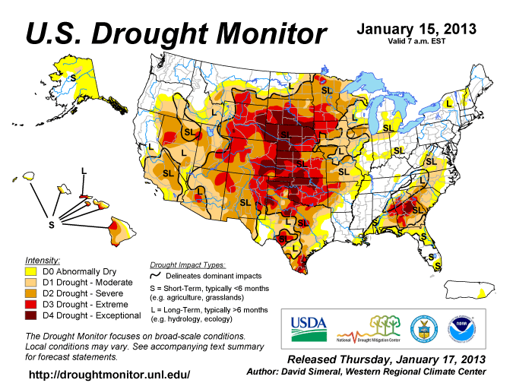
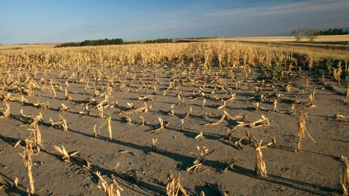
More Droughts
Loss of summer arctic cooling of Northern Hemisphere
Lower crop yields, food insecurity, malnutrition, disease, population displacement, armed conflict
Notes:
Photo: ABC news/Getty images, found at http://abcnews.go.com/blogs/technology/2012/07/whos-most-to-blame-for-global-warming/ 1/27/13

Slide 32
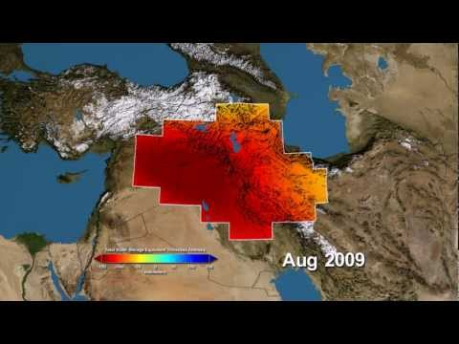
Without Water, Revolution
By THOMAS L. FRIEDMAN
NYT: May 18, 2013
TEL ABYAD, Syria — “…between 2006 and 2011, some 60 percent of Syria’s land mass was ravaged by the drought and, with the water table already too low and river irrigation shrunken, it wiped out the livelihoods of 800,000 Syrian farmers and herders…”
Satellites Reveal Depletion of a Vital Middle East Water Supply
By ANDREW C. REVKIN
NYT: February 12, 2013
Notes:
http://www.nytimes.com/2013/05/19/opinion/sunday/friedman-without-water-revolution.html?pagewanted=all&_r=0
I came here to write my column and work on a film for the Showtime series, “Years of Living Dangerously,” about the “Jafaf,” or drought, one of the key drivers of the Syrian war. In an age of climate change, we’re likely to see many more such conflicts.
“The drought did not cause Syria’s civil war,” said the Syrian economist Samir Aita, but, he added, the failure of the government to respond to the drought played a huge role in fueling the uprising. What happened, Aita explained, was that after Assad took over in 2000 he opened up the regulated agricultural sector in Syria for big farmers, many of them government cronies, to buy up land and drill as much water as they wanted, eventually severely diminishing the water table. This began driving small farmers off the land into towns, where they had to scrounge for work.
Because of the population explosion that started here in the 1980s and 1990s thanks to better health care, those leaving the countryside came with huge families and settled in towns around cities like Aleppo. Some of those small towns swelled from 2,000 people to 400,000 in a decade or so. The government failed to provide proper schools, jobs or services for this youth bulge, which hit its teens and 20s right when the revolution erupted.
Then, between 2006 and 2011, some 60 percent of Syria’s land mass was ravaged by the drought and, with the water table already too low and river irrigation shrunken, it wiped out the livelihoods of 800,000 Syrian farmers and herders, the United Nations reported. “Half the population in Syria between the Tigris and Euphrates Rivers left the land” for urban areas during the last decade, said Aita. And with Assad doing nothing to help the drought refugees, a lot of very simple farmers and their kids got politicized. “State and government was invented in this part of the world, in ancient Mesopotamia, precisely to manage irrigation and crop growing,” said Aita, “and Assad failed in that basic task.”

Slide 33
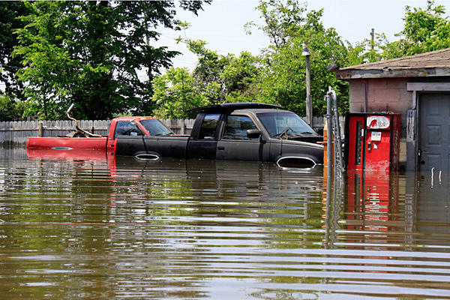
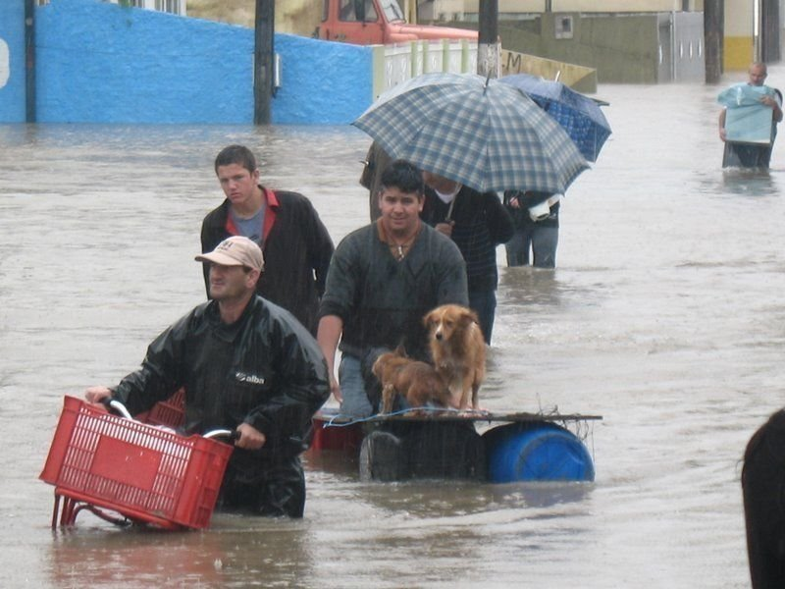
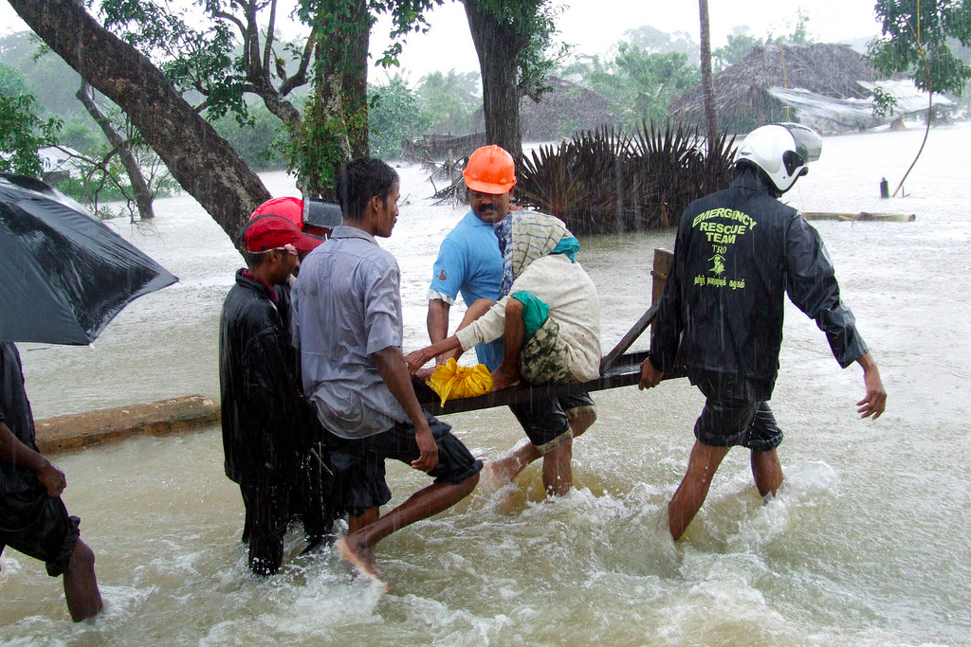
Increased Storms and Flooding
Direct injuries and deaths
Long term psychological and physical effects
Increased risk of infectious diseases
Contaminated water supplies
Superstorm Sandy: $62 billion in damages
Notes:
Reference New Orleans, Louisiana, Hurricane Katrina
Flooding will become more common. As global temperatures rise, the global water cycle is accelerated and the amount of water vapor in the atmosphere increases. The result is more intense downpours, even when total precipitation remains unchanged.
References:
(1)Millennium Ecosystem Assessment, 2005. Ecosystems and Human Well-being: Synthesis. Island Press, Washington, DC.
(2) Milly PCD, Wetherald RT, Dunne KA and Delworth TL. Increasing Risk of Great Floods in a Changing Climate. Nature (2002); 415: 514-517.
Photos (left to right):
Orkut images, Wikimedia Commons, http://commons.wikimedia.org/wiki/File:Itajai_floods.jpg
Trokilinochchi, Wikimedia Commons, http://commons.wikimedia.org/wiki/File:Woman_in_Sri_Lanka_rescued_during_monsoon_flooding.jpg

Slide 34
Respiratory disease, asthma and allergies
Longer pollen season with higher counts
Mold and mildew in houses after flooding
Smoke from fires
Higher ozone levels
Crowley RA. Climate Change and Health: A Position Paper of the American College of Physicians. Annals of Internal Medicine 2016;164:608-10
Notes:
Crowley RA (2016). Climate Change and Health: A Position Paper of the American College of Physicians. Annals of Internal Medicine

Slide 35
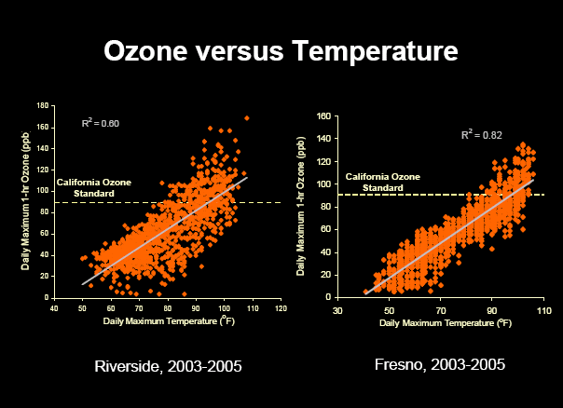
Heat increases ozone
Notes:
Source: http://www.aqmd.gov/tao/conferencesworkshops/GlobalWarmLocalAP/CroesSlides2.pdf, via Gina Solomon
The data come from http://nature.berkeley.edu/ahg/pubs/future.pdf (Influence of future climate and emissions on regional air quality in California by Allison L. Steiner,1 Shaheen Tonse,2,3 Ronald C. Cohen,4,5 Allen H. Goldstein,1 and Robert A. Harley3) J Geophysical Research.
See also Patz J et al 2015 JAMA Climate Change and Global Health Challenges.
.

Slide 36
Psychological effects
Post-traumatic stress disorder (e.g., after natural disasters)
Depression, despair ...

Slide 37
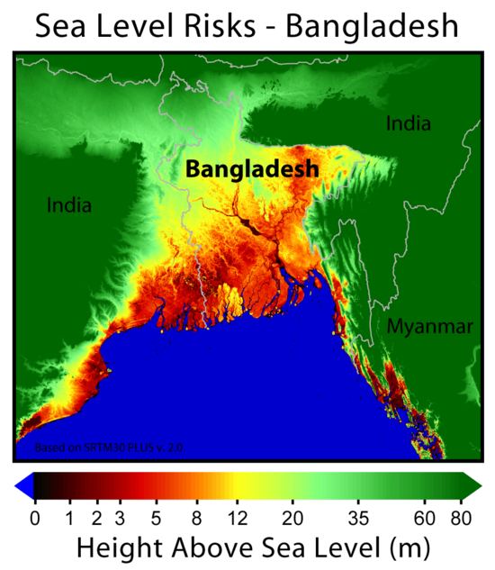
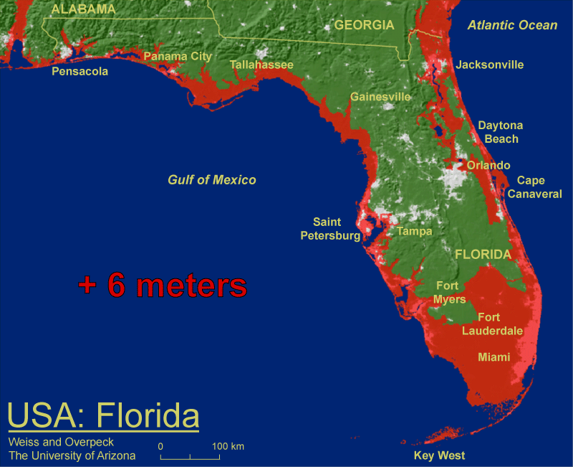
Sea Level Rise
More coastal flooding during storms
Salt water intrusion into fresh water supplies
Population displacement, refugees, armed conflict
Over last 3 million years when temps were 2-3°C higher, sea levels were 6 meters higher*
*IPCC AR-5
Notes:
From AR5: http://www.stopgreensuicide.com/Ch13_sea-level_WG1AR5_SOD_Ch13_All_Final.pdf. Florida picture: why 6 meters?
Paleo sea level records from warm periods during the last 3 million years provide medium-to-high 16confidence that global mean sea level was more than 6 m higher than present when global temperature 17was 2°C–3°C warmer than present. During the Last Interglacial Period, for the time interval in which 18global mean sea level was above present, the maximum 1000-year average rate of global mean sea level rise 19very likely exceeded 2.0 m kyr–1, likely exceeded 4.1 m kyr–1, and was unlikely to have exceeded 5.8 m kyr–1. 20Faster rates lasting less than a millennium cannot be ruled out. Because these periods give only a limited 21analogy for future anthropogenic climate change, we do not consider that they provide upper bounds for 22global mean sea level rise during the 21st century. [Chapter 5, 13.2.1, Figure 13.3]. Rise in AR-5 estimated at 29 to 82 cm (11” to 32”).
See also: https://arxiv.org/pdf/1211.4846.pdf
It’s not just increasingly intense precipitation events that will lead to more flooding in a warmer world. Rising sea levels will also lead to widespread coastal flooding as global warming progresses. Higher temperatures cause sea level rise by expanding ocean water, melting glaciers and small ice caps and provoking sections of Greenland and Antarctic ice sheets to melt.
Over the last century, sea level rose by about 4.5 to 8.5 inches, and the IPCC projects that global warming could cause an additional 7 to 23 inch rise in sea level by 2100 (“excluding rapid dynamical changes in ice flow” .(1) More recently, research published in the journal Science indicates that the recently observed accelerations in the melt and flow of land-based ice sheets in Greenland and Antarctica could contribute to a much more substantial sea level rise, ranging from 20 to 55 inches by the end of the century.(2) A rise of this magnitude would have serious implications for coastal cities and towns around the globe.
Even a rise in sea level within the range projected by the IPCC (40cm, or approximately 16 inches by 2080) would result in an increase in the number of people at risk of flooding by coastal storm surges from the current 75 million to 200 million people.(1)
Salt marshes, mangroves and other coastal wetland ecosystems that important habitats for many species will be greatly threatened by rising sea levels. These ecosystems are also vital in fishing, recreation and other economically important activities. (3)
Rising sea levels will increase the salinity levels in surface and ground water as a result of salt water intrusion. Not only will this harm plants and animals in estuaries, but it will also threaten sources of water for human consumption. (4)
References:
(1) IPCC. Climate Change 2007: The Physical Science Basis, Summary for Policymakers. Contribution of Working Group I to the Fourth Assessment Report of the Intergovernmental Panel on Climate Change. Available at: http://www.ipcc.ch
(2) Rahmstorf S. A Semi-Empirical Approach to Projecting Future Sea-Level Rise. Science; Published online December 14, 2006; 10.1126/science.1135456
(3) And (4) Coastal Zones and Sea Level Rise:
http://www.epa.gov/climatechange/effects/coastal/index.html
Photos: EPA: http://www.epa.gov/climatechange/effects/coastal/index.html
See also: http://www.miamiherald.com/news/state/florida/article12983720.html#storylink=cpy
State environmental officials ordered not to use the terms “climate change” or “global warming” in any government communications, emails, or reports.

Slide 38
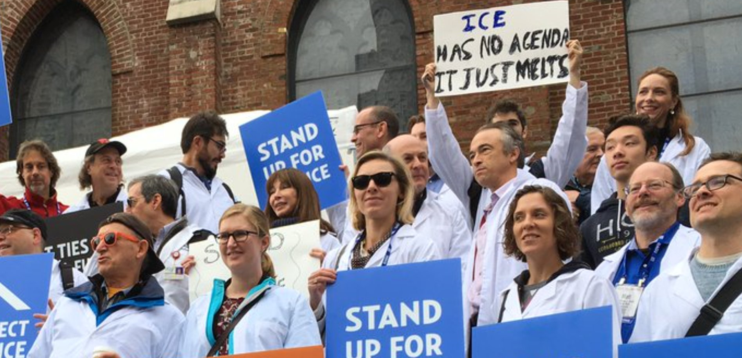
Stand Up For Science Demonstration in SF, 12/13/16
Notes:
Downloaded from: https://twitter.com/climatetruth/status/808779632539529216?lang=en
SF Bay Area PSR President Bob Gould has the Giants hat, TN and DR. Jan Kirsch 1 row down. This was part of the American Geophysical Union meeting demonstration. See http://www.livescience.com/57201-agu-scientists-rally-to-protect-science.html

Slide 39
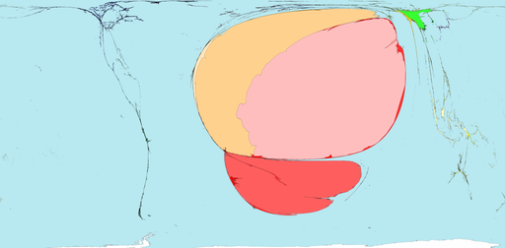
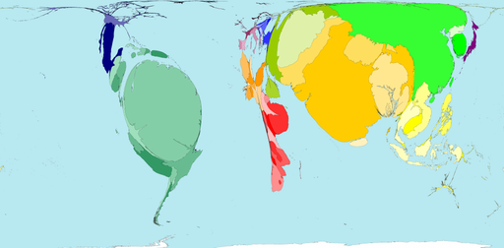
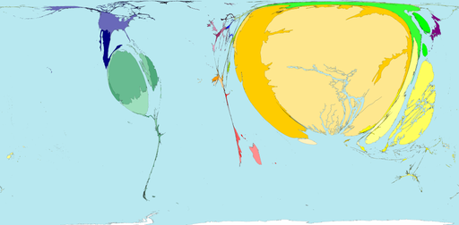
Who is affected?
www.worldmapper.org
Carbon emissions, 2000
Killed by Drought,1975-2000
Killed by Floods, 1975-2000
Killed by Storms, 1975-2000
Notes:
Up until this point, we’ve been talking mostly about things that we are seeing – and are likely to see more of -- here in the US. But the worst effects of climate change are already being felt, and will continue to be felt, in the poorest parts of the world. These countries are at least able to protect themselves against heat, droughts, storms and floods. For them, climate change means loss of land, increased starvation, and even more devastating poverty than they already experience.
These countries do not have the infrastructure and resources that our country has to deal with the problems caused by climate change. Americans have always been proud of their generosity in helping people around the world in times of disaster. Well, we need to take real action now in order to stop some very serious disasters BEFORE they occur.
See also http://abcnews.go.com/blogs/technology/2012/07/whos-most-to-blame-for-global-warming/
39

Slide 40
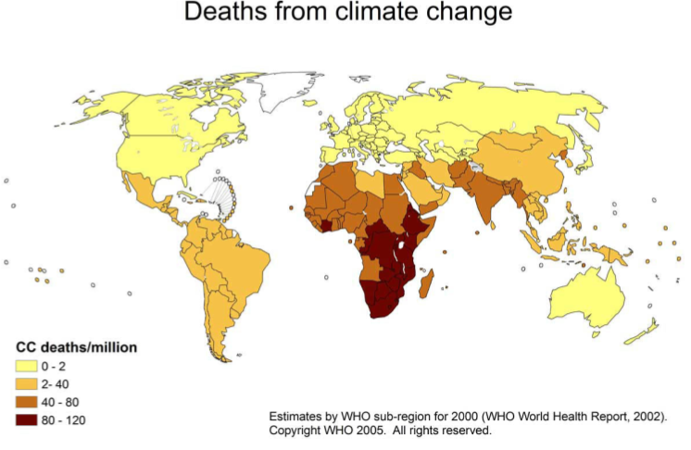
Deaths Attributed to Climate Change: 150,000 per year
Notes:
From the moderate to the catastrophic, the impacts of global warming together constitute one of the gravest threats to public health that the world has ever confronted. In the face of so many grim projections, it is easy to overlook the tremendous toll on human life already being taken. The World Health Organization estimates that global warming is responsible for 150,000 deaths and five million disability adjusted life years (DALYs – a measure of years of life lost due to premature mortality combined with years of life lived with disability) annually. Though these health impacts are global in scope, you can see by looking at the figure here that their distribution is highly unbalanced, with poor, developing nations bearing the brunt of global warming.(1) As emissions and temperatures continue to rise, this disparity will only grow larger.
References:
Patz JA, Campbell-Lendrum D, Hollaway T, Foley JA. Impact of Regional Climate Change on Human Health. Nature. 2005; 438: 310-317.
WHO SOURCE: http://www.who.int/heli/risks/climate/climatechange/en/index.html

Slide 41
Global warming made simple
It’s real
We’re causing it (unequally)
It’s bad for us (unequally)
There are things we can do
There are “co-benefits” to doing them
Notes:
This slide, particularly, adapted from Ed Maibach Center for Climate Change Communication
#1. Global warming is real.
#2. We’re causing it.
#3. It’s a grave threat to us, especially to our children and their children.
#4 There are things we can do
#5 There are other good raesons to do almost all of them
We’re going to talk about all of these things today, but we’re going to spend most of our time talking about the 3rd point – the fact that global warming is very bad for people, not just bad for plants, penguins and polar bears – and the 4th point – that we can solve this problem -- because my mission as a public health professional is to help create a community, and a world, in which we and our children, can all live as healthfully as possible. For that to remain true, there are some important steps we are going to have to take.
Finally, I think this last point -- co-benefits– is very important. By that I mean that many of the steps we need to take would be good things to do even if they weren’t necessary to reduce the impact of global climate change.

Slide 42

Estimating your carbon footprint
Many online calculators
Best ones include food, show effects of changes you can make, and are state-specific
Google “Carbon footprint calculator”
  (I recommend The Nature Conservancy site.)
  Also Google “Footprint Network”
Per capita US carbon footprint ~21 tons (per EPA in 2014)
Notes:
Graphic from http://www.carbonfootprint.com/calculator.aspx accessed 1/2/11
Nature conservancy site: http://www.nature.org/greenliving/carboncalculator/index.htm
Note EPA calculator does not include food or airplane travel! Focuses on little things you can do.
Per capital carbon footprint based on US EPA ~7 billion tons per year:
https://www.epa.gov/ghgemissions/us-greenhouse-gas-inventory-report-1990-2014 accessed 3/10/17

Slide 43
Importance of airplane travel
1 East Coast round trip from California = 1-2 tons CO₂
Typical California per capita household electricity consumption ~ 3 tons CO₂
Reduce travel by
  Combining trips
  Skipping trips
  Videoconferencing, Skype, etc.
Notes:
http://www.arb.ca.gov/cc/ccc/ccc.htm
Higher estimates for travel factor in “radiative forcing”– the fact that GHG emitted at high altitude have a greater effect.
++++++++++++++++++++++++++ From http://www.pge.com/about/environment/calculator/assumptions.shtml accessed 1/2/11:
Average Per Capita CO₂ Emissions (Energy and Vehicle Use)Average Californian 22,941 lbs CO₂ per person Assumptions:
2005 California Per Capita Electricity Usage: 7,032 kWh (** 1644 total for T & J Newman)
2005 California Per Capita Natural Gas Usage: 422 therms
California Emissions Rate for Delivered Electricity: 0.879 lbs CO₂ per kWh
Emissions Rate for Natural Gas: 13.446 lbs CO₂ per therm
(So in California 5674 # CO2 from natural gas and 6181 # from electricity and
12,000 miles per year and 21 miles per gallon for average passenger vehicle – 11,0857 for driving = 5 tons
Burning 1 gallon of gasoline produces 19.4 lbs CO₂
Typical Californian:
~3 tons for electricity
~2.5 tons for natural gas
~5 tons for driving
~4 tons for food (goes down to

Slide 44
Carbon Offsets
Basic idea: for each ton of CO₂ you generate, absorb or prevent a ton from another source
Examples
  Subsidize new renewable energy projects (e.g., wind farms)
  Methane capture from manure
  Tree planting (not as good)
Many websites now sell carbon offsets, generally < $30/ton
Notes:
More info:
http://greentravelerguides.com/tips/carbon-offsets/
US EPA estimates the entire USA GHG footprint at 7 billion metric tons:
https://www.epa.gov/ghgemissions/overview-greenhouse-gases
Divided by 320 million people, this is

Slide 45
Carbon Offsets – Controversies*
Comparison to indulgences in middle ages
  Pay money instead of repenting and changing
  Satirized, e.g. CheatNeutral.com
Analogies fail because CO₂ is fully interchangeable
  Emitting 1 ton and preventing another ton is the same as not emitting 1 ton and not preventing the other ton
  Passes the “What if everybody did it?” test
Problem: being sure you are preventing that other ton from being emitted.
  Various levels of certification available
*Thanks to Peter Bacchetti
Notes:
45
Thanks to Peter Bacchetti for finding Cheat Neutral and the first 2 points on this slide.

Slide 46
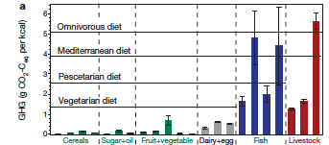

GHG footprint of foods per kcal
Tilman D, Clark M. Nature, 2014

Slide 47
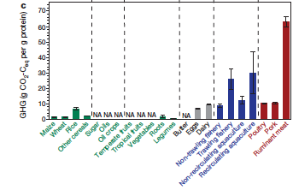
GHG footprint of foods per gram protein
Tilman D, Clark M. Nature, 2014; 515:518-22

Slide 48
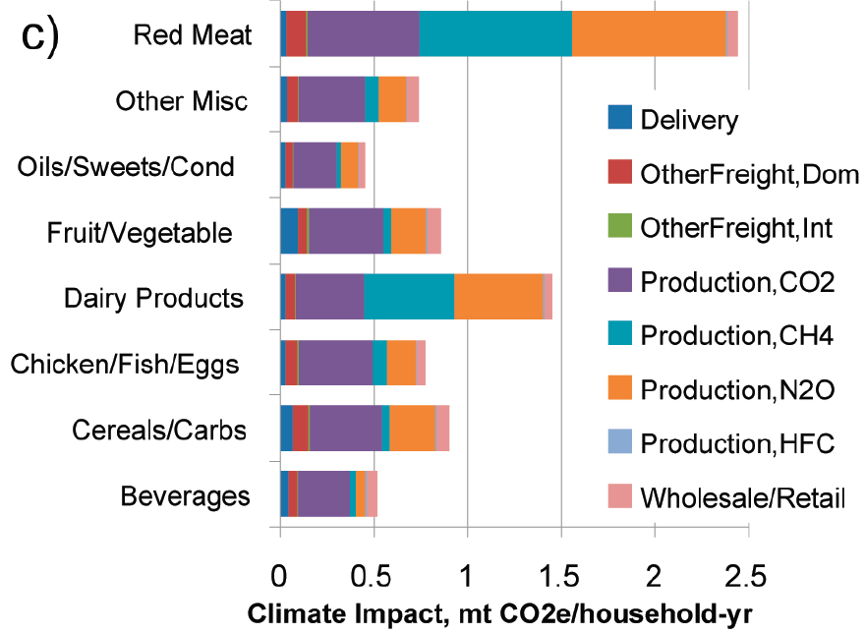
Sources of climate impacts of different foods*
*Weber CL and Matthews HS. Food-miles and the relative climate impacts of food choices in the US. Environ Sci Technol 2008;42:3508
48
Notes:
This is per year for average household. Note BIG methane and N2O contributions from red meat and dairy. N2O= Nitrous oxide. Nitrous oxide from meat comes from fertilizer used to grow feed and from their wastes.
This slide illustrates that delivery and freight GHG (which are less for local food) are a very small part of the carbon footprint of the diet.

Slide 49
Carbon footprint of your food*
Red meat @ 49% of calories ~ SUV
Poultry, fish, dairy, eggs @ 28% of calories ~Camry
Plants only ~ Prius
*Gidon E, Martin PE. Diet, energy and global warming. Earth Interactions 2006; 10:1-17. http://pge.uchicago.edu/workshop/documents/martin1.pdf.
Based on 8332 vehicle miles traveled, US per capita average
Notes:
Based on per capita vehicle miles traveled becomes 8332, of which an estimated 63% are traveled on highways

Slide 50
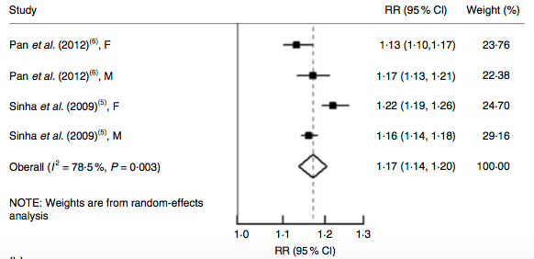
Co-benefit of eating less red meat: living longer
Fig. 3 Risk of all-cause mortality associated with each serving per day of total red meat
Pooled HR = 1.17
Wang X et al. Red and processed meat consumption and mortality:
dose–response meta-analysis of prospective cohort studies. Public Health Nutrition 2016; 19:893-905. They call them RR but they are actually HR.
Notes:
Fig. 3 Risk of (a) all-cause mortality, (b) cardiovascular mortality and (c) cancer mortality associated with each serving per day of total meat.
I^2 indicates heterogeneity, suggesting differences between estimates are not due to chance. Conclusion that eating more meat is associated with higher mortality is the same in all studies listed.
The pooled RR is 1.17 which is for a 100 g (3 oz) serving

Slide 51
Is a hazard ratio for total mortality of ~1.17 per 100g of meat per day a lot?
The HR for smoking up to ½ pack per day (10 cigarettes) is about 1.3*.
So HR of up to 5 cigarettes/day might be Sqrt(1.3) = ~1.14
So a 100 g serving of red meat has an effect on life expectancy similar to 3 cigarettes
Or 1 oz red meat ~ 1 cigarette
*Jacobs D et al Cigarette smoking and mortality risk: twenty-five-year follow-up of the Seven Countries Study. Arch Intern Med. 1999 Apr 12;159(7):733-40
Notes:
Jacobs D et al Cigarette smoking and mortality risk: twenty-five-year follow-up of the Seven Countries Study. Arch Intern Med. 1999 Apr 12;159(7):733-40.
HR for smoking < 10 cigs/ day 1.3
So increase of 2 servings/d of red meat like smoking up to ½ ppd. 1 serving ~ 3 cigarettes
Public Health Nutr. 2015 Jul 6:1-13. [Epub ahead of print]
Red and processed meat consumption and mortality: dose-response meta-analysis of
prospective cohort studies.
Wang X(1), Lin X(2), Ouyang YY(3), Liu J(3), Zhao G(4), Pan A(5), Hu FB(6).
Author information:
(1)1Department of Maternal and Child Health Care,School of Public Health,Shandong
University,Jinan,People's Republic of China. (2)2Department of Nutrition and Food
Hygiene,School of Public Health,Shandong University,Jinan,People's Republic of
China. (3)3Department of Nutrition and Food Hygiene,School of Public
Health,Tongji Medical College,Huazhong University of Science and
Technology,Wuhan,People's Republic of China. (4)4Department of Cardiovascular
Sciences,Shandong Provincial Hospital affiliated to Shandong
University,Jinan,People's Republic of China. (5)5Department of Epidemiology and
Biostatistics,MOE Key Lab of Environment and Health,School of Public
Health,Tongji Medical College,Huazhong University of Science and
Technology,Wuhan,People's Republic of China. (6)6Departments of Nutrition and
Epidemiology,Harvard T. H. Chan School of Public Health,655 Huntington
Avenue,Boston,MA 02115,USA.
OBJECTIVE: To examine and quantify the potential dose-response relationship
between red and processed meat consumption and risk of all-cause, cardiovascular
and cancer mortality.
DESIGN: We searched MEDLINE, Embase, ISI Web of Knowledge, CINHAL, Scopus, the
Cochrane library and reference lists of retrieved articles up to 30 November 2014
without language restrictions. We retrieved prospective cohort studies that
reported risk estimates for all-cause, cardiovascular and cancer mortality by red
and/or processed meat intake levels. The dose-response relationships were
estimated using data from red and processed meat intake categories in each study.
Random-effects models were used to calculate pooled relative risks and 95 %
confidence intervals and to incorporate between-study variations.
RESULTS: Nine articles with seventeen prospective cohorts were eligible in this
meta-analysis, including a total of 150 328 deaths. There was evidence of a
non-linear association between processed meat consumption and risk of all-cause
and cardiovascular mortality, but not for cancer mortality. For processed meat,
the pooled relative risk with an increase of one serving per day was 1·15 (95 %
CI 1·11, 1·19) for all-cause mortality (five studies; P<0·001 for linear trend),
1·15 (95 % CI 1·07, 1·24) for cardiovascular mortality (six studies; P<0·001) and
1·08 (95 % CI 1·06, 1·11) for cancer mortality (five studies; P<0·001). Similar
associations were found with total meat intake. The association between
unprocessed red meat consumption and mortality risk was found in the US
populations, but not in European or Asian populations.
CONCLUSIONS: The present meta-analysis indicates that higher consumption of total
red meat and processed meat is associated with an increased risk of total,
cardiovascular and cancer mortality.

Slide 52
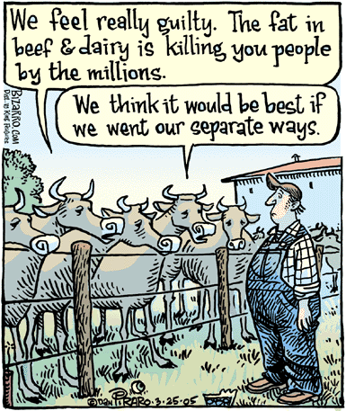

Slide 53

Center for Investigative Reporting (CIR) estimate for the external costs: $1.51/burger.
These are costs paid not by the consumer (in worse health), but externalized to the consuming country (health costs) and other (mostly poor) people around the world.
Notes:
Time Magazine 8/31/09
The warning reads, ‘This hamburger may be hazardous to your health. Why the American food system is bad for our bodies, our economy and our environment and what some visionaries are trying to do about it.
CIR: http://cironline.org/reports/hidden-costs-hamburgers-3701
Foer: http://bigthink.com/videos/the-200-fast-food-burger
Both accessed 2/16/16

Slide 54
Root Cause #2: Market failure
"Climate change is a result of the greatest market failure the world has seen…”
  ---Stern Review on the Economics of Climate Change
Notes:
This article suggests replacing “failure” with “absence.”
https://www.forbes.com/sites/timworstall/2015/01/25/nick-stern-is-wrong-climate-change-is-not-the-largest-market-failure-the-world-has-ever-seen/#50e6f7c2571c

Slide 55
Climate Change is an “Externality”
A cost or benefit from an activity or transaction that affects an otherwise uninvolved party that did not choose to incur that cost or benefit
"Corporations are externalizing machines. They're constantly figuring out ways to get somebody else to pay their costs of production. That's their nature."
  ~ Robert F. Kennedy Jr.

Slide 56
We know enough to act
“I would not agree that [human activity] is a primary contributor to the global warming that we see…We need to continue the debate and continue the review and the analysis.”
  −Scott Pruitt, EPA Chief, 3/9/17
Given catastrophic risks and disproportionate effects, even low probability would warrant action
Notes:
Pruit quote: Source: https://www.washingtonpost.com/news/energy-environment/wp/2017/03/09/on-climate-change-scott-pruitt-contradicts-the-epas-own-website/?utm_term=.17a6087bb83d

Slide 57

UC Leadership
UCOP Carbon Neutrality initiative
  Carbon neutrality by 2025
UCSF Office of Sustainability
Sustainable Business Magazine, Jan 2017

Slide 58
What we need to do
Put a price on carbon (Join Citizens Climate Lobby)
Speak up
Improve healthcare value
Divest from fossil fuel companies
Join a group! Work together!
  SF Bay Area PSR Environmental Health Committee 7 PM Wed 4/12, MH 2500
  Academic Senate Sustainability
  350.org
Stand up for science!

Slide 59

Speak Up

Slide 60
Improve Healthcare Value
Discretionary funding for ANYTHING (including infrastructure, conservation, renewable energy) severely constrained by healthcare costs
Trying to reduce the environmental footprint from healthcare without examining what we do is like trying to reduce our footprint from travel without considering what trips we take.
  UCSF Academic Senate Sustainability Task Force

Slide 61
Improve Healthcare Value
US annual healthcare spending ~$10,000/year per person
This is about $3000/year more than 2nd highest spending country (Switzerland)
US annual carbon footprint per person ~21 tons/year
Cost to offset at $30/ton = $630/year
This is $630/$3000 = 21% of excess annual US healthcare spending
  (Or about 1/3 of the proposed DOD budget.)
This is probably a high estimate for carbon neutrality
D. Squires and C. Anderson, U.S. Health Care from a Global Perspective: Spending, Use of Services, Prices, and Health in 13 Countries, The Commonwealth Fund, October 2015.
Notes:
Defense; proposed spending $583B/year
https://www.defense.gov/News/News-Releases/News-Release-View/Article/652687/department-of-defense-dod-releases-fiscal-year-2017-presidents-budget-proposal.

Slide 62
Divestment Math: 3 numbers*
2° C: Need to keep temperature rise below this number to avoid catastrophe
565 gigatons: the amount of additional CO₂ we can add to the atmosphere and still have some hope of staying below a 2° C increase
2,795 gigatons: the amount of CO₂ from burning known reserves of fossil fuel
*McKibben W. http://www.rollingstone.com/politics/news/global-warmings-terrifying-new-math-20120719
Notes:
http://www.rollingstone.com/politics/news/global-warmings-terrifying-new-math-20120719

Slide 63
The Case for Divestment
Known fossil fuel reserves are their assets. Must be extracted and burned to retain their value.
Must be largely stranded if planet is to survive
Extremely rich and powerful
  Ability to buy scientists, media, politicians, and laws
Notes:
“And yet they relentlessly search for more hydrocarbons – in early March, Exxon CEO Rex Tillerson told Wall Street analysts that the company plans to spend $37 billion a year through 2016 (about $100 million a day) searching for yet more oil and gas.” –From the Rolling Stone article.
37,000 million//365 = 100 million

Slide 64

Long day working on healthcare cartoon

Slide 65
Summary
Climate change poses grave threats to health of people and the planet
Healthcare contributes because of its own large footprint and its costs
You can reduce your own environmental footprint by conserving energy, reducing travel, eating less meat, and offsetting carbon
This will not be enough. We all need to become change agents!
  Improve healthcare value
There are CO-BENEFITS

Slide 66

San Mateo-Hayward Bridge
Notes:
This is the San Mateo bridge – the longest bridge in the Bay Area and (according to Wikipedia), the 25th longest bridge in the world.

Slide 67

Existing sign outside Foster City Costco, 2001
Notes:
It used to be very easy to get on the San Mateo Bridge by accident, leading to an unwanted round trip to Hayward. The two left lanes in the photo must go to Hayward, but it is easy to miss the sign.

Slide 68
E-mail excerpts - #1
Below is the result of your feedback form. Wednesday, September 5, 2001 at 20:41:08
-------------------------------------------------------------------------
On behalf of the Social Action Committee of the Unitarian
Universalists of San Mateo (which thinks globally and acts locally), I'm writing to call attention to a problem that wastes time and energy.
The problem is that it is too easy accidentally to get on Highway 92 Eastbound at Foster City Blvd, and be forced to drive all the way to Hayward…

Slide 69
E-mail excerpts -#7
At 02:32 PM 10/22/2002 -0700, Robert_Haus@dot.ca.gov wrote:
Dear Dr. Newman:
I forwarded your remarks, once again, to the person in charge of Signing for San Mateo County…
As we said previously: Signing is a matter of balance... Too few signs can lead to confusion, but too many signs can lead to the same result…

Slide 70
E-mail excerpts, #28
December 12, 2004
Greetings, Mr. Haus --
I was over at the Foster City Costco this afternoon, so naturally my thoughts turned to you. How are you doing? I hope you have a happy holiday season, and don't forget that the wish of the Unitarian Universalists of San Mateo this year, as in 2001, 2002, and 2003, is that someday every trip to Hayward will be a wanted trip to Hayward.
Will our wish someday come true? You could make it happen.

Slide 71

Entrance to San Mateo Bridge (before)
Notes:
Social Action Committee members with DOT staff

Slide 72

Entrance to San Mateo Bridge (after
September,
2005)

Slide 73


Slide 74

LAST EXIT

Slide 75

What we need to do: Everything
NRDC, based on Pacala and Socolow, Science 2004
Notes:
Example wedge– nrdc. The Y axis is gigatons CO2e/year emissions. Based on original article by Pacala and Socolow (Science, 2004).

Slide 76


Instead of this
We get this
Notes:
And instead of powering our communities with fuels that emit vast amounts of greenhouse gas pollution, we can power our communities with clean renewable energy sources, that eventually will be far cheaper than what we pay today for dirty fossil fuels.
In short, the solutions to climate change will also produce solutions to many of societies most pressing problems.

Slide 77


Instead of this
We get this
Notes:
Today, highways define our nation, but we can build a nation defined by its walking and cycling paths, its public transportation systems, and by jobs and schools that are closer to home (possibly even at home) rather than ever-increasing distances away from home.

Slide 78

Notes:
I got it from Funny Times; easy to find on the Internet, e.g., http://www.dailydawdle.com/2010/11/what-if-its-big-hoax-and-we-create.html

Slide 79


Slide 80
Additional slides

Slide 81
UCSF School of Medicine Leadership on Healthcare Value
“Choosing Wisely” campaign of the American Board of Internal Medicine
  Catherine Lucey, Robert Wachter
“Less is More” in the Archives of Internal Medicine
  Rita Redberg and Deboray Grady
American College of Physicians “High Value Cost Conscious Care” initiative
  Molly Cooke, Christopher Moriates
CTSI Center for Healthcare Value
  Adams Dudley, George Sawaya

Slide 82


References and Resources

Slide 83

Cheat Neutral
Notes:
Steve and Lisa met while on holiday in Spain, and quickly fell head over heels for each other. That Christmas, at his office party, Steve got drunk and unavoidably repeatedly cheated on Lisa with Cheri, a co-worker. He paid Cheatneutral just £2.50 and we invested his money in Alex, a single man with no prospect of finding a partner. In return for the payments, Alex agreed to remain single.

Slide 84
Carbon Offsets Controversies
“What is Cheat Offsetting?
When you cheat on your partner you add to the heartbreak, pain and jealousy in the atmosphere. Cheatneutral offsets your cheating by funding someone else to be faithful and NOT cheat. This neutralises the pain and unhappy emotion and leaves you with a clear conscience.
“Can I offset all my cheating?
  First you should look at ways of reducing your cheating. Once you've done this you can use Cheatneutral to offset the remaining, unavoidable cheating.”
http://www.cheatneutral.com accessed 6/2/10
Notes:
84
so far, cheatneutral has offset 65, 768 cheats and has 9002 faithful people ready to neutralise your misdemeanours.
Projects
Our projects
We at Cheatneutral are committed to saving relationships, promoting fidelity, and making people feel good about themselves. Our projects have a great success rate.
Some of the people who are offsetting your cheating: Steve and Lisa
Steve and Lisa met while on holiday in Spain, and quickly fell head over heels for each other. That Christmas, at his office party, Steve got drunk and unavoidably repeatedly cheated on Lisa with Cheri, a co-worker. He paid Cheatneutral just £2.50 and we invested his money in Alex, a single man with no prospect of finding a partner. In return for the payments, Alex agreed to remain single.
Thanks to Cheatneutral, Steve was able to come clean about his cheating to Lisa, and when he presented her with the Cheatneutral certificate they realised they wanted to get married. Their wedding is taking place in the summer. Steve continues to regularly cheat on Lisa and Cheatneutral continues to fund projects like Alex with his offset payments.

Slide 85
Carbon Offsets: Evaluation
Certification
  Do independent auditors verify claims?
  “Gold” standard toughest
Additionality
  Could the project have happened anyway?
  Economic viability
    Irony: generating energy from methane capture reduces “additionality” because the project becomes more economically viable

Slide 86

Costs of Carbon Offsets
Marked variability in price for a clear conscience:
Cost in same range as the value of frequent flier miles
All websites accessed 1/28/08, based on 4838 miles
Notes:
CCX = Chicago Carbon Exchange
CRS - Center for Resource SolutionsResponsible for running the Green-e programme and tracking REC Credits
Gold- http://www.cdmgoldstandard.org/
Carbon Offsets see: http://www.cleanair-coolplanet.org/ConsumersGuidetoCarbonOffsets.pdf
Terrapass $5.95/ton 1/2/12 and Carbon fund

Slide 87

Natural Catastrophes Worldwide
Notes:
The statistics/analyses provided here are the property of Munich Reinsurance Company. They may be used without charge in printed and electronic media, provided Munich Reinsurance Company is named as the source.
Dear Professor Newman,
Thank you for your e-mail. You may use our graphs, please state "Munich Re NatCatSERVICE" as source. You find the graphs in our downloadcenter: www.munichre.com/natcatservice/downloadcenter/en.
Best regards
Angelika
Angelika Wirtz
Head of NatCatSERVICE
Geo Risks Research/Corporate Climate Centre
Munich Reinsurance Company
Koeniginstrasse 107, 80802 Munich, Germany
Telephone +49 89 3891-3453
Telefax +49 89 3891-73453
E-Mail: awirtz@munichre.com
http://www.munichre.com/app_pages/www/@res/pdf/media_relations/company_news/2011/2011_11_11_app1_en.pdf

Slide 88

Cumulative carbon emissions
Notes:
http://abcnews.go.com/blogs/technology/2012/07/whos-most-to-blame-for-global-warming/

Slide 89
UCSF School of Medicine Leadership
“Choosing Wisely” campaign of the American Board of Internal Medicine
  Catherine Lucey, Robert Wachter
“Less is More” in the Archives of Internal Medicine
  Rita Redberg and Deboray Grady
American College of Physicians “High Value Cost Conscious Care” initiative
  Molly Cooke, Christopher Moriates
CTSI Center for Healthcare Value
  Adams Dudley, George Sawaya, Chris Moriates

Slide 90


Slide 91

Possible Temperature Changes*
Source: Intergovernmental Panel on Climate Change (IPCC) 2014 Synthesis Report
Notes:
RCP= Representative Concentration Pathway
The numbers (2.6, 8.5, etc.) refer to radiative forcing, in very simple terms, the number of watts per square meter by which the energy coming in from the sun exceeds that going out.
Source: Figure SPM 7 from IPCC Climate Change 2014 Synthesis Report Summary for Policy Makers, available at:
https://www.ipcc.ch/pdf/assessment-report/ar5/syr/AR5_SYR_FINAL_SPM.pdf
Accessed 7/31/16

Slide 92

Sea Level Rise under IPCC AR-5 Scenarios
RCP *(= Representative Concentration Pathway) 2.6: Stringent mitigation scenario
RCP 6.0, 8.5: Business as usual
Notes:
RCP= Representative Concentration Pathway
The numbers (2.5, 4.5, etc.) refer to radiative forcing, in very simple terms, the number of watts per square meter by which the energy coming in from the sun exceeds that going out.
Source: Figure SPM.6 from IPCC Climate Change 2014 Synthesis Report Summary for Policy Makers, available at:
https://www.ipcc.ch/pdf/assessment-report/ar5/syr/AR5_SYR_FINAL_SPM.pdf
Accessed 7/31/16

Slide 93

Notes:
EXHBIT 3
No 17.8%:
https://www.cms.gov/research-statistics-data-and-systems/statistics-trends-and-reports/nationalhealthexpenddata/nationalhealthaccountshistorical.html

Slide 94

Carbon footprint of your food*
Livestock contribution to global warming: 18% of global greenhouse gases
  Deforestation
  N₂O: 296 x CO₂ Global Warming Potential (GWP)
  CH₄: 23 x CO₂ GWP
  Increasing steeply
Source: *UN Food and Agriculture Organization, U.N. News Centre. 29 Nov 06
Notes:
FAO = UN Food and Agriculture Organization

Slide 95

Carbon footprint of your food*
*Gidon E, Martin PE. Diet, energy and global warming. Earth Interactions 2006; 10:1-17. http://pge.uchicago.edu/workshop/documents/martin1.pdf
Notes:
Figure 3. The greenhouse burden (considering CO2, N2O, and CH4) exerted by
various plant- and animal-based diets. Each of the five lines represents a
semirealistic mixed diet. All five diets have the same caloric intake, and
all are considered for animal portion of calories, , in the range 0%–50%.
The differences in GHG burden among various car models are shown;
e.g., the difference between a Toyota Camry and a Prius, 1.05 ton CO2 per
person per year, is the lowermost horizontal dotted line. The percent of
animal-based product in various diets that must be consumed to equal
those added burdens are also shown with vertical tick marks. For example,
the added GHG emissions associated with the difference between
a red meat diet and a plant-based one is comparable to the difference
between a Toyota Camry and an SUV, 2.52 ton CO2 per person per year,
when the portion of animal-based calories in the diet is 26%. While the
blue curve involves only caloric efficiency, and therefore can span the
entire range, the mean composition, 27.7% of calories from animal
sources, is shown by the vertical gray line, along with the added GHG
burden associated with this diet, ∼1.5 ton CO2 per person per year.
Based on per capita vehicle miles traveled becomes 8332, of which an estimated 63% are traveled on highways

Slide 96
Double-edged sword of “co-benefits
Good: Win-Win situation
Bad: potential loss of critical thinking. I favor this action anyway, so I don’t critically look at evidence for a new reason for doing it. Examples:
  If I oppose killing animals, I am likely to favor studies showing worse environmental and health consequences of meat
  If I am suspicious of large corporations, I will favor more local electricity generation
Kahneman D. Thinking fast and slow. Shermer M. The believing brain.

Slide 97
My biases
Concerned about sustainability, climate change, children and future generations
but
I tend to be frugal and skeptical
I favor informed decision-making
I enjoy eating meat
I like to travel

Slide 98

BLAST
(50% of total)
http://blog.360cities.net/hiroshima-after-the-atomic-bomb/
Notes:
The energy released by a nuclear explosion comes as:
Blast (which means the concussive force of the explosion)
as Light & Heat
and as Radiation.
Blast is about half the energy released. It is an instantaneous release that sends out a wave of energy that will extend for miles with a force far greater than any tornado or hurricane.
This is a picture of Hiroshima 2 months after the explosion.

Slide 99

HEAT
(35% of total)
Thermal energy is 35% of total. In first seconds, temperatures are the same as the sun. Severe burns for those not vaporized.
http://life.time.com/history/hiroshima-portraits-of-survivors/#13
Notes:
The intense flash of light can blind those who look at it. The heat released is also instantaneous and massive with temperatures equal to the burning sun. So intense that objects vaporize. Burns would be a common, almost universal injury for survivors and would far exceed our ability to care for them. The picture is of a boy being checked 4 years after the Hiroshima explosion and shows his burn scars.

Slide 100


IONIZING
RADIATION
(15% of total)
1.
Death or Illness
Effects both immediate and long lasting.
2.
1. http://science.howstuffworks.com/nuclear-meltdown-disasters-pictures.htm#page=12
2. http://www.compassionmed.org/transnistria_2006.html
Notes:
Radiation is the unique risk of these weapons. The illnesses caused by radiation result in death in days to weeks. This is true regardless of any other injury. Even in those not immediately made ill, radiation exposure can cause cancers for years in the future.

Slide 101
The problem: Market failure
"Climate change is a result of the greatest market failure the world has seen…The problem of climate change involves a fundamental failure of markets: those who damage others by emitting greenhouse gases generally do not pay.”
  ---Stern Review on the Economics of Climate Change

Slide 102
Climate Change is an “Externality”
A cost or benefit from an activity or transaction that affects an otherwise uninvolved party that did not choose to incur that cost or benefit
"Corporations are externalizing machines. They're constantly figuring out ways to get somebody else to pay their costs of production. That's their nature."
  ~ Robert F. Kennedy Jr.

Slide 103

Recall Lancet quote: “Climate change could be the biggest global health threat of the 21st century…”
Why just “could be”?
Nuclear weapons!

Slide 104

Key Nuclear Weapons messages
They are different
Current US arsenal of ~800 megatons is hard to justify
US spending on nuclear weapons is about $4 million/hour
The UN is currently considering a nuclear weapons ban treaty
Notes:
About 33.3 billion/year ($1 trillion over next 30 years)
=$91. million/day = $3.8 million/hour

Slide 105

They are different
“The unleashed power of the atom has changed everything save our modes of thinking and we thus drift towards unparalleled catastrophe.”
--Albert Einstein
Notes:
Easy to find this quote with Google.

Slide 106

Energy in a sugar cube
Old way of thinking chemical energy: 5 g x 3.4 kcal/g = 17 kcal
Energy for 10 minutes
New way of thinking: E= mc²
5 g x (3 x 10¹⁰ cm/sec)²
= 45 x 10²⁰ ergs
= 2.15 x 10¹⁰ kcal
Energy for 123,000 years
21 kilotons
Notes:
This calculation is intended to illustrate Einstein’s point.
Energy in 1 gram of mass = 1 g X (3 x 10^10 cm/sec))^2 = 9 x 10^20 ergs
1 cal = 4.18 x 10^7 ergs. So energy content in 1 gram of sugar = 2.15 x 10^13 cal or 2.15 x 10^10 kcal. At 2400 cal per day this is 9x 10^6 days or 24,657 years.; 5 g is enough for 123,000 years
One Kiloton = 10^9 kcal
So the energy in a cube of sugar is 2.15 e10 kcal/1e9Kcal/kt = 21.5 kilotons TNT
Of course only a small amount of mass (about a sugar cube’s worth) is converted to energy in a nuclear explosion, most of the fissile material remains intact or is in fission products, some of which are radioactive.

Slide 107

Explosive yield
1 kiloton = explosive power of 1000 TONS (2 million pounds) of TNT
Hiroshima bomb 13 kilotons
Oklahoma City bomb (1995): 2.2 tons (.002 kilotons)
1 megaton = 1000 kilotons
Largest nuclear weapons: 20 megatons
= Freight train full of TNT stretching from Los Angeles to New York City
Notes:
Picture of Murrah Federal Building from http://www.geocities.com/everwild7/art/tomb.jpg. That bombing killed 168 people and injured more than 680 others
Yield of truck bomb available multiple places on the web. LA to NYC is 2462 miles.
Say typical box car is 45 feet and 70 tons, then 20,000,000 tons TNT x 45 ft/70 tons x 1 mile/5280 ft = 2435 miles. These are ballpark estimates.

Slide 108
Effects of Nuclear Weapons
Blast
Heat
Radiation
Ecological
Notes:
http://www.fas.org/nuke/intro/nuke/effects.htm

Slide 109

Effect of a 150 kt bomb on SF
https://nuclearsecrecy.com/nukemap/
Notes:
This is another way to think about the effects of a nuclear weapon.
Here is a map illustrating the impact of a single nuclear weapon of 150 kilotons. This is approximately 10 times larger than the Hirsohima bomb. The very center is the fireball with its vaporizing heat.
The second circle (the green one) is the area of radiation that would cause between 50 and 90% immediate mortality.
The third is the circle showing where the Blast force is still strong enough to collapse most building and injure almost everyone.
The last ring shows where the heat would still be enough to set fire to all flammable material and cause third degree burns on exposed skin.

Slide 110
BB Demonstration
One BB = 130 kilotons of explosive power
  About 10 Hiroshima-sized bombs
  87% of one W-80 bomb shown with NukeMap
Total US nuclear arsenal, 4480 warheads, ~800 megatons
~6000 BBs
Notes:
Estimate of current US arsenal from:
http://www.tandfonline.com/doi/full/10.1080/00963402.2016.1264213 ; The number of warheads including those awaiting dismantlement is 6780.

Slide 111

Nuclear Weapons Ban Treaty
ICAN = International Campaign to Abolish Nuclear Weapons
  (PSR, IPPNW major players)
United Nations voted October 27, 2016 to move forward with negotiations to abolish nuclear weapons
(Already required under the Nuclear Nonproliferation Treaty)
(Nuclear weapons states and some allies voted no.)

Slide 112

Co-benefit of eating less meat: lower ischemic heart disease rates
Key TJ et al. Mortality in vegetarians and non-vegetarians: a collaborative analysis of 8300 deaths among 76,000 men and women in five prospective studies. Public Health Nutr 1998;1:33-41.
Notes:
Key TJ et al. Mortality invegetarians and non-vegetarians: a collaborative analysis of 8300 deaths among76,000 men and women in five prospective studies. Public Health Nutr. 1998Mar;1(1):33-41.

Slide 113

Divestment movement
192 Campus organizations in 1st month
Seattle City Employees’ Retirement System (SCERS)
Support from Nelson Mandela
“If it's wrong to wreck the climate then it's wrong to profit from that wreckage.” – Bill McKibben, 350.org
Notes:
Go Fossil Free
Do the Math:
PhotoL http://www.350.org/en/node/28949
Seattle City Employees’ Retirement System (SCERS) divesting $17.6 million
http://www.greenbiz.com/blog/2012/12/24/350-divestment-campaign Pro divestment
http://www.climatesciencewatch.org/2012/12/21/fossil-fuel-divestment/ Source for McKibben and Klein quotes
“Just like getting off drugs, the hard work of carbon detox is ultimately ours. No one can do it for us. But in order for us to have a fighting chance of kicking the habit we have to get the pushers out of our faces. And the pushers are the fossil fuel companies, the global carbon cartel. Going after them won’t solve the problem, but it will create the necessary conditions for us to solve it ourselves.” – Naomi Klein http://www.climatesciencewatch.org/2012/12/21/fossil-fuel-divestment/

